Slide 1
Late Chinese Dynasties

Slide 2
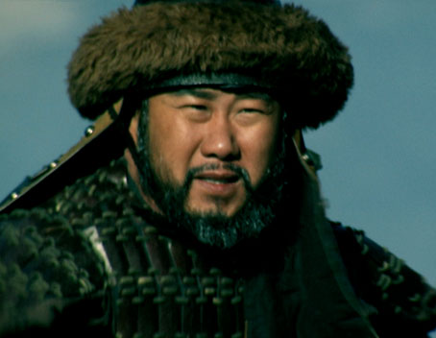
Article Questions
1. How did the “nice” weather help Genghis Khan conquer his empire?
2. How did scientists estimate the weather activity for the time period of Genghis Khan’s rule?
3. If precipitation stays the same over the next generation, how could Mongolia still experience a drought?

Slide 3
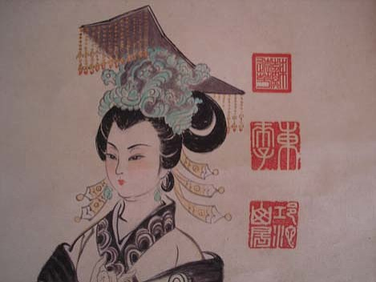
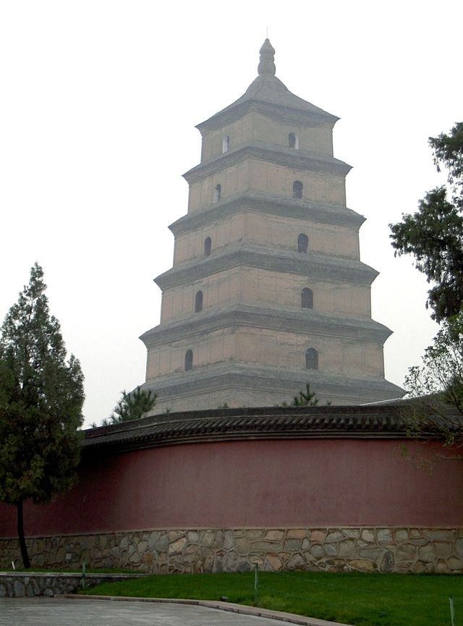
I. The Chinese Golden Age (618-1279 AD)
A. Tang restored a strong central government with bureaucracy after a period of disunity
B. Buddhism became the main religion

Slide 4
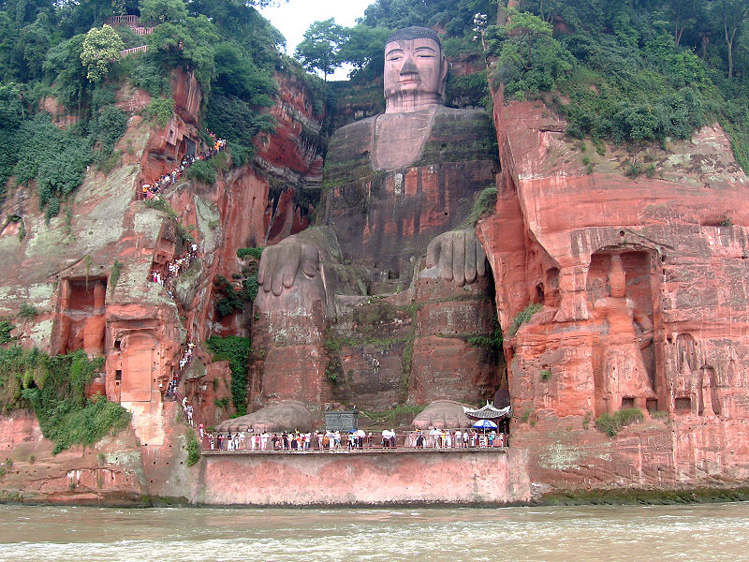

Slide 5
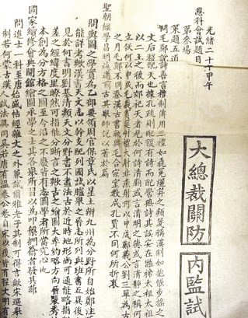
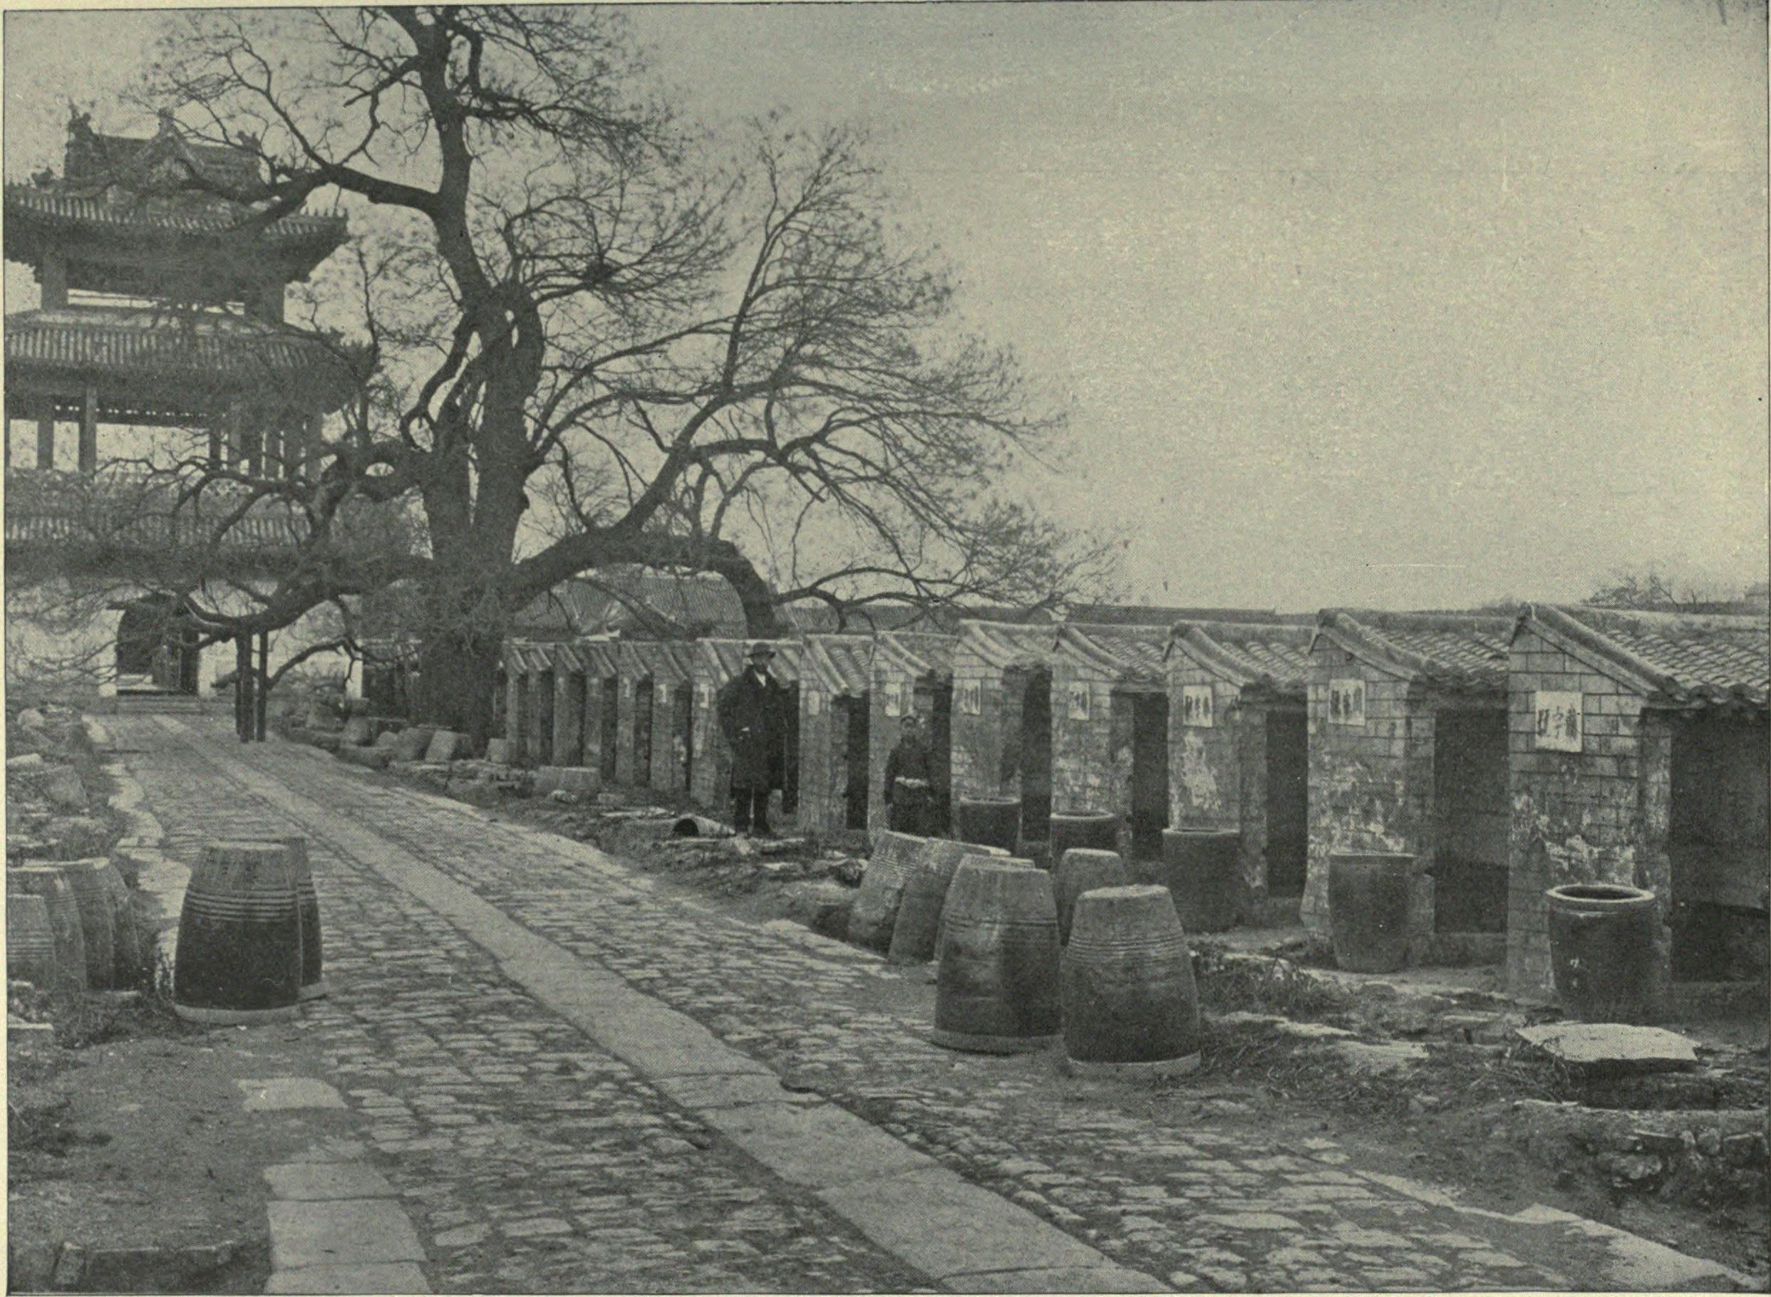
C. Expanded the civil service system to allow any person to try to take the exams- great honor and status to pass

Slide 6
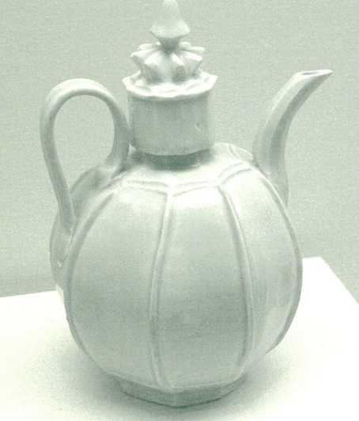
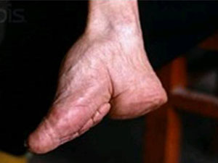
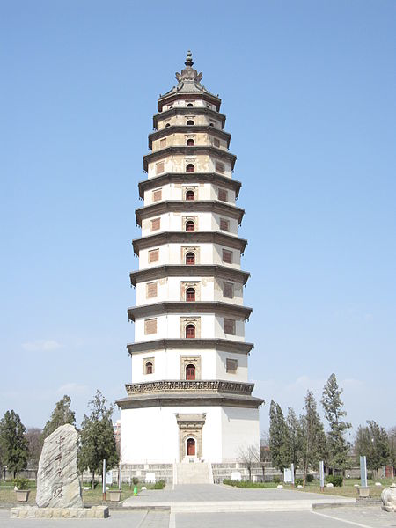
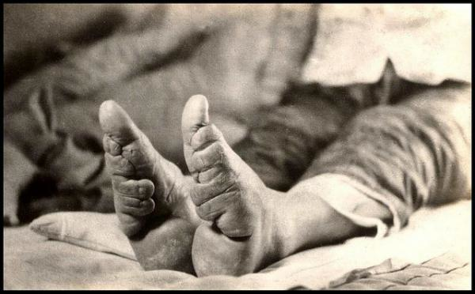
D. Inventions: printing press, gunpowder, paper money, compass, porcelain
E. Practiced foot binding- limited women’s movement

Slide 7
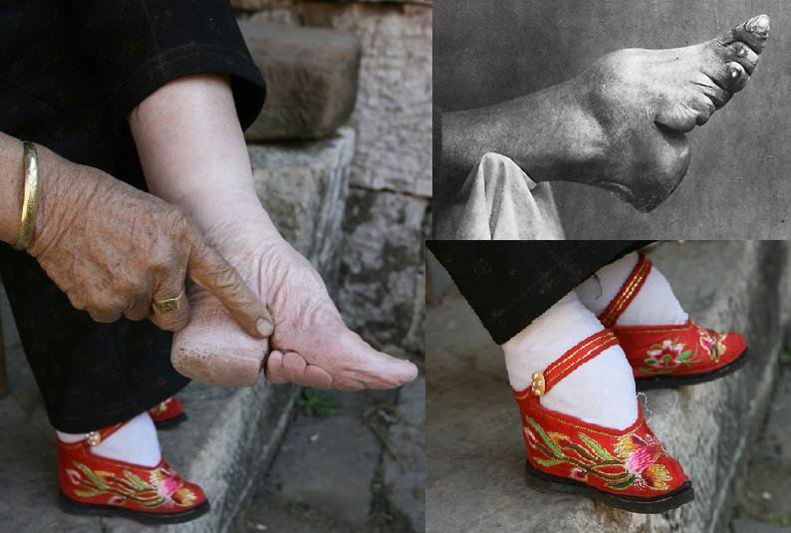

Slide 8
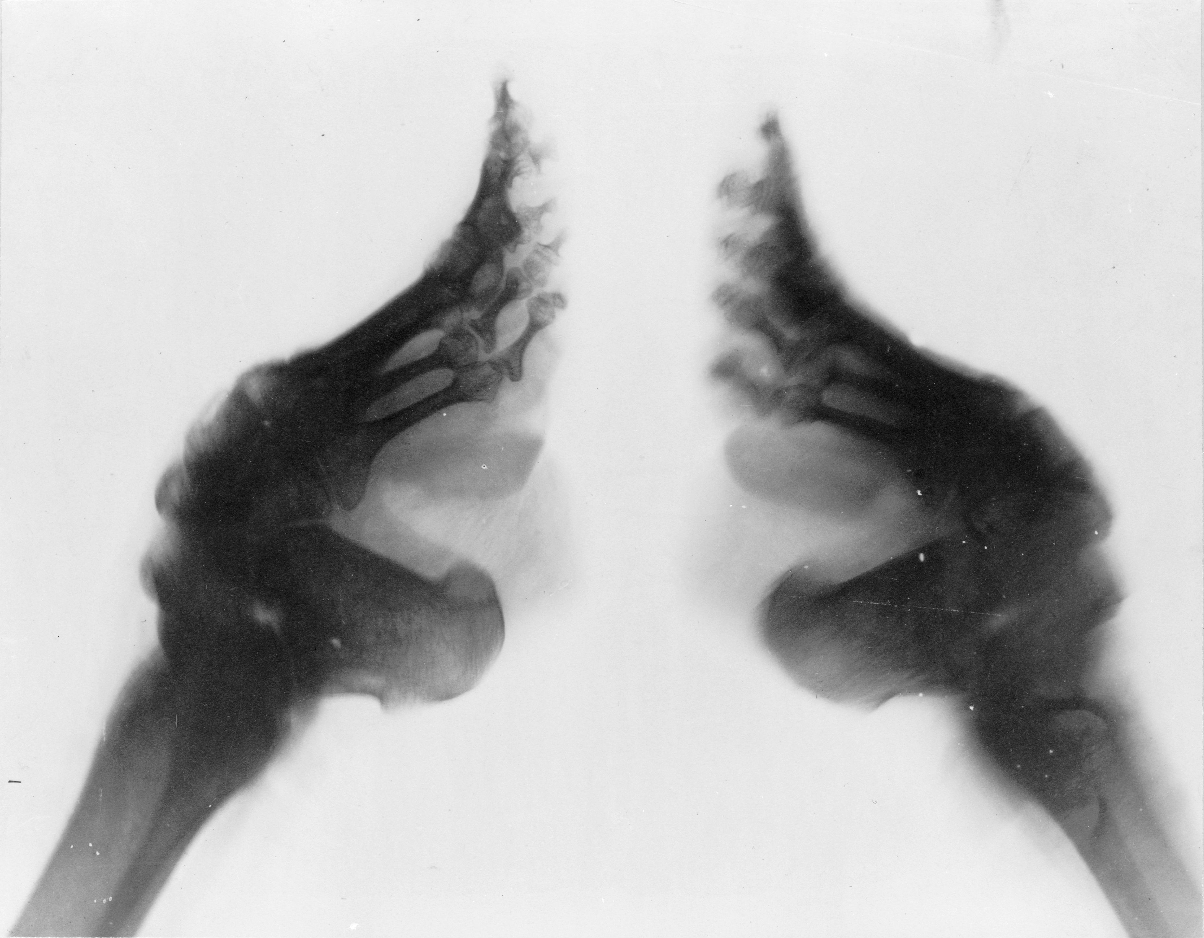

Slide 9
T-P-S Discussion
Why would the Chinese practice foot binding?
What purpose would it serve in Chinese society?
Can you compare the practice of foot binding to something in today’s society?

Slide 10
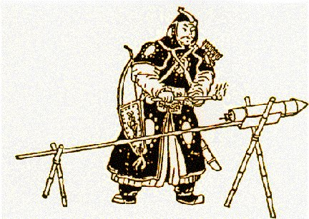
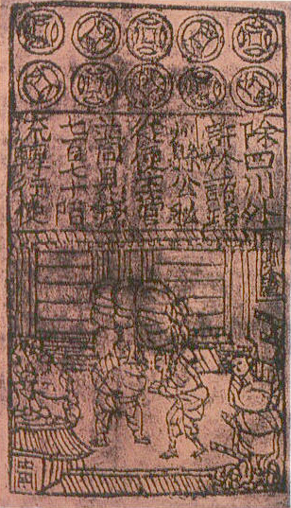
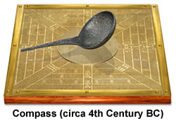
D. Inventions: printing press, gunpowder, paper money, compass
E. Overthrown by the Mongols

Slide 11
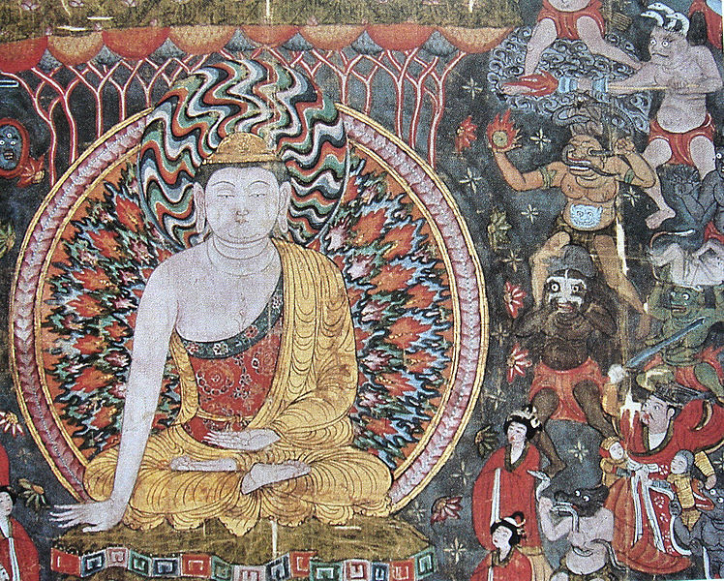

Slide 12
warm up…
Have you gotten tired of charts yet?
Regardless of what you answered, take out the Chinese Dynasty Comparison Chart (Tang/Song sheet from yesterday) and begin filling in the blanks that you know.

Slide 13
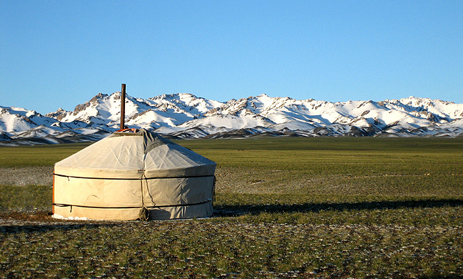
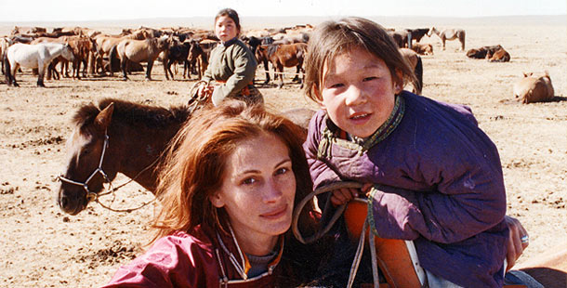
III. The Mongolian Empire
A. The Mongols were a nomadic pastoralist people from central Asia with a history of invading China
http://www.youtube.com/watch?v=2mbWp2Xa6wI

Slide 14
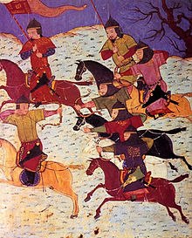
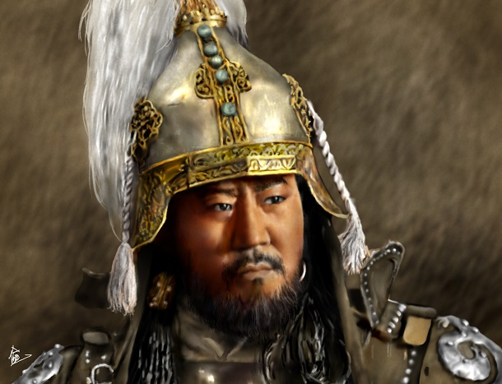
B. Tribes united by Genghis Khan (universal ruler)- 1206 AD
great military leader who used his cavalry to defeat all enemies - What is a cavalry?

Slide 15
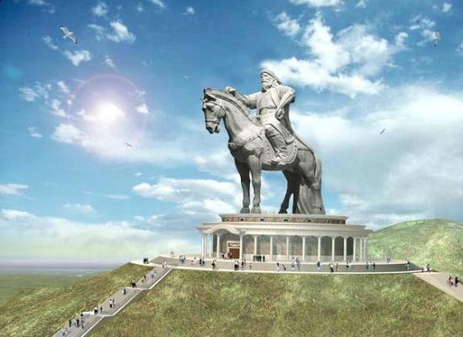

Slide 16
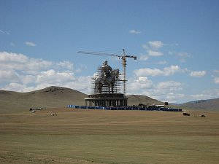

Slide 17
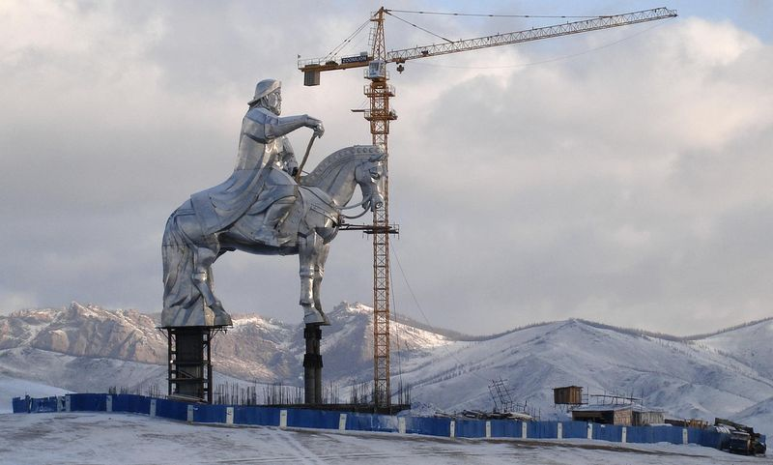

Slide 18
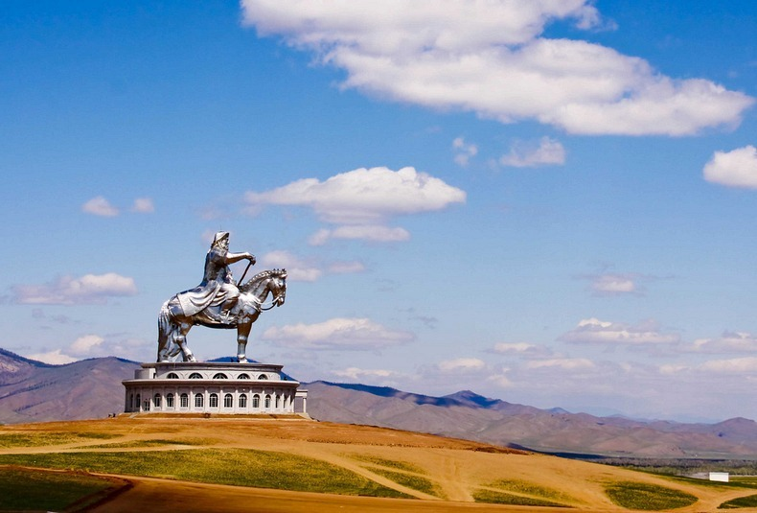

Slide 19
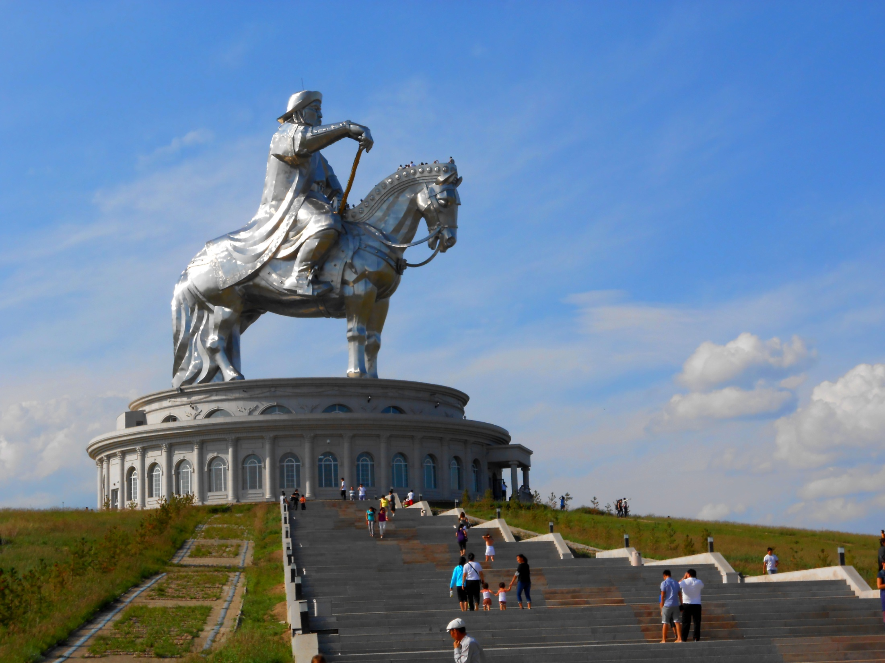

Slide 20
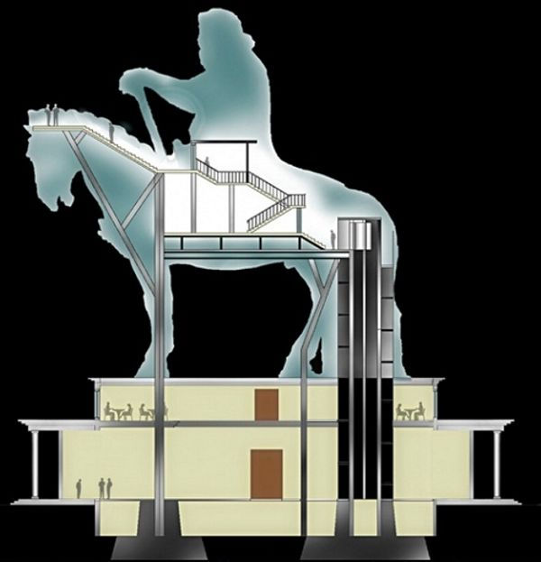

Slide 21
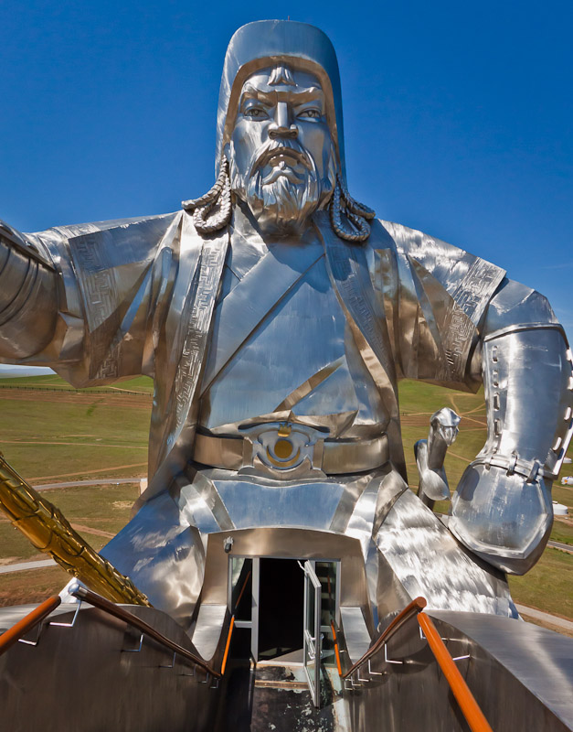

Slide 22
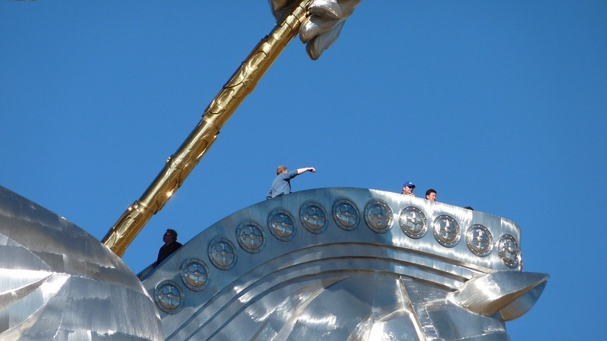

Slide 23
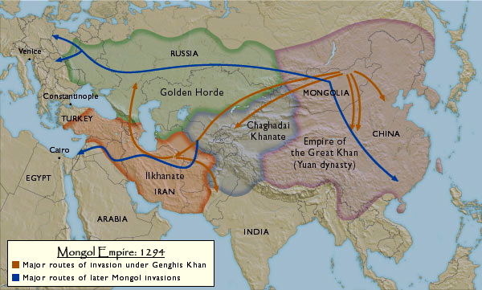
2. Enemy cities were either destroyed or became tributary states- self rule, but must give resources
3. After Genghis Khan died, empire split in four empires- Pax Mongolia (era of Mongol peace)

Slide 24
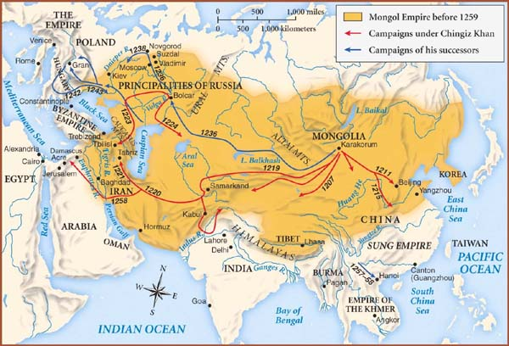

Slide 25
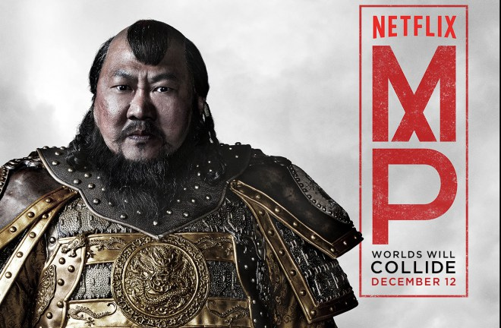
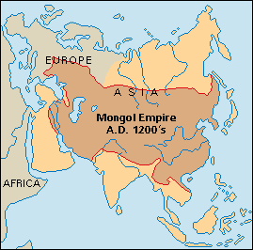
C. The Yuan Dynasty (1279-1368): Mongol Rule
1. Kublai Khan (Genghis Khan’s grandson) conquered China and declared himself emperor

Slide 26
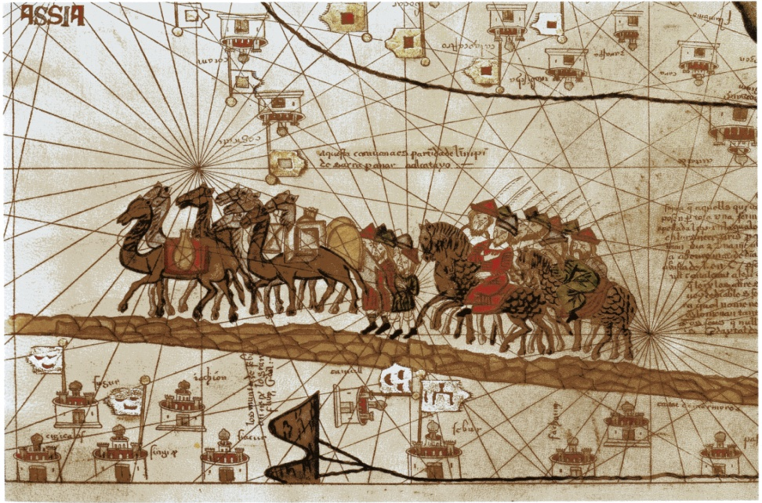
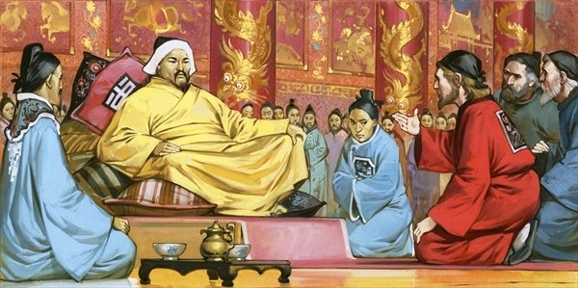
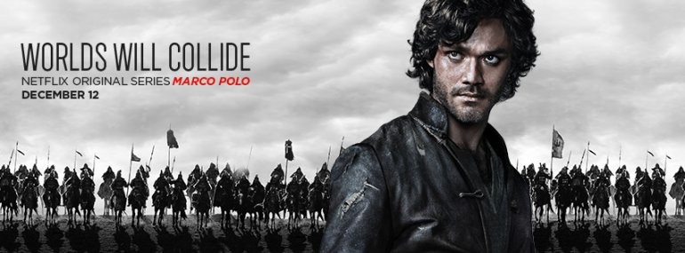
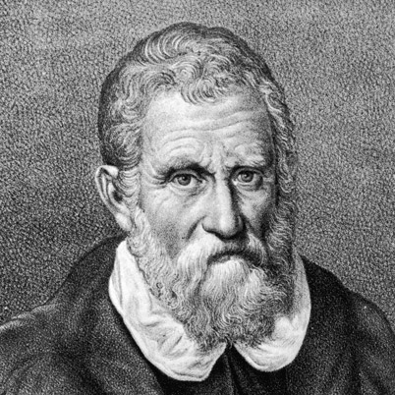
2. Visited by the European explorer Marco Polo
3. Tried to invade Japan but defeated by typhoons

Slide 27
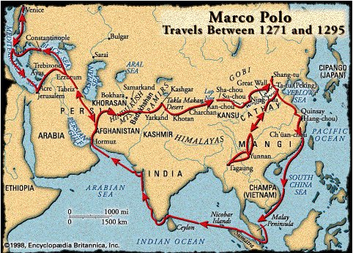

Slide 28
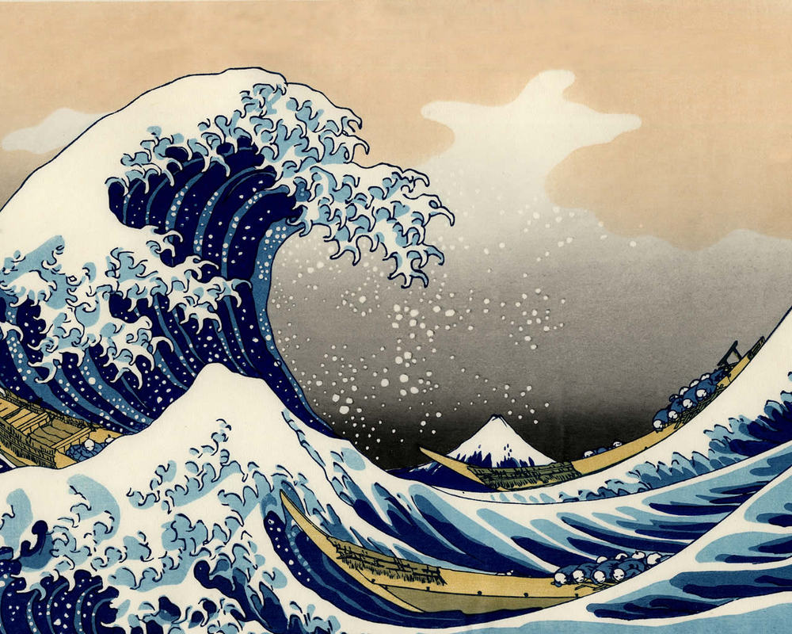

Slide 29
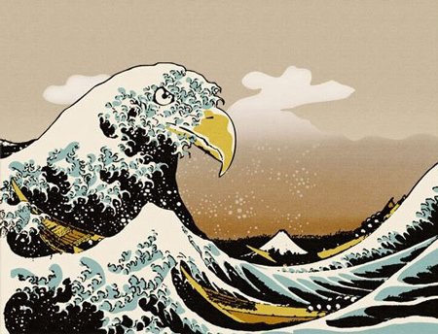

Slide 30
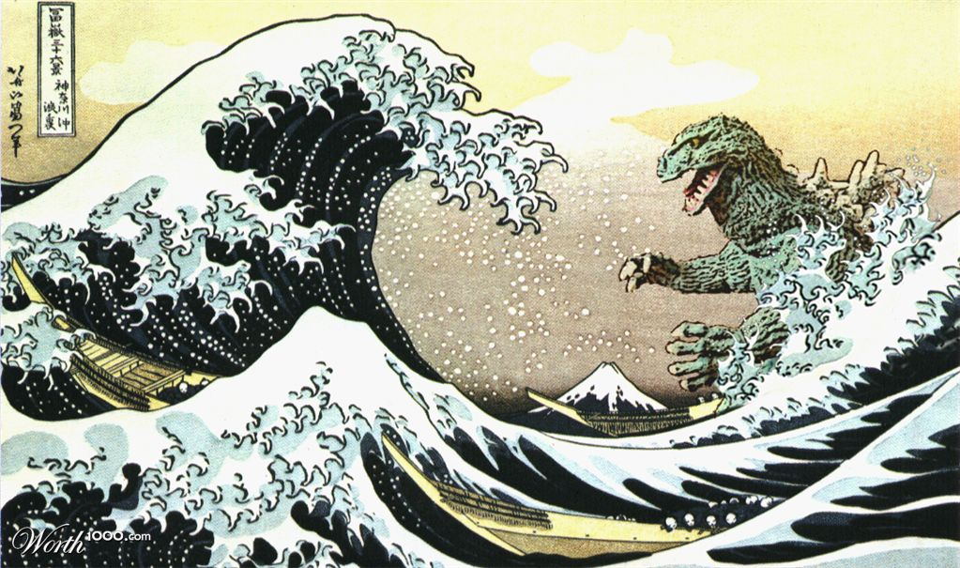

Slide 31
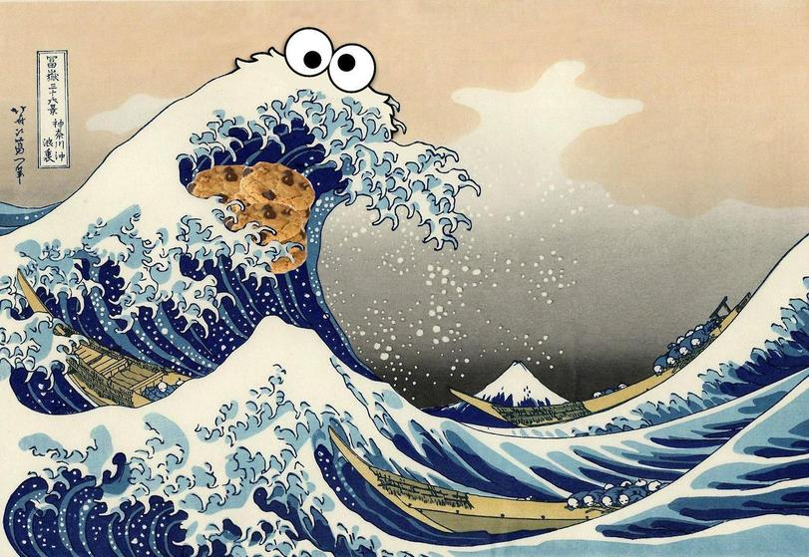

Slide 32
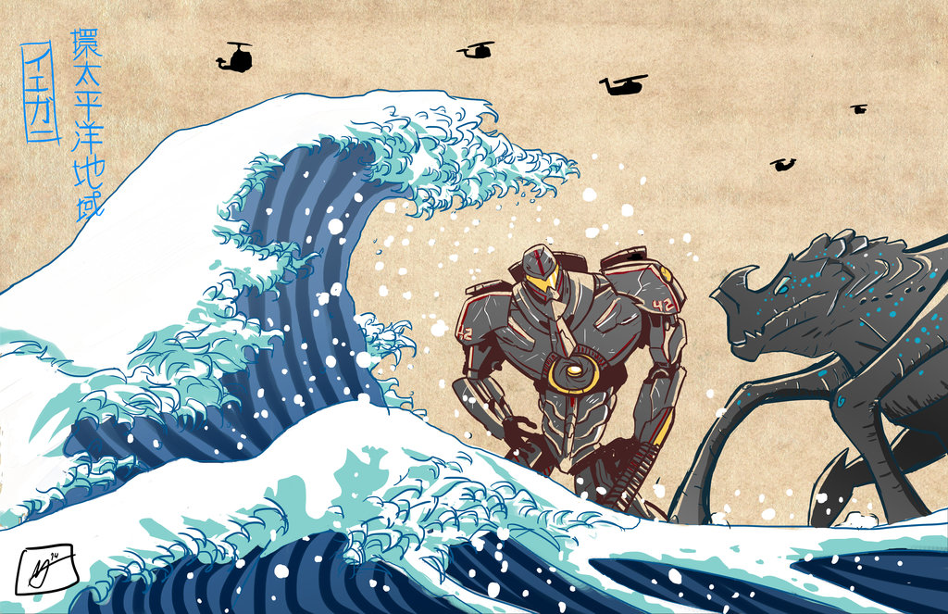

Slide 33
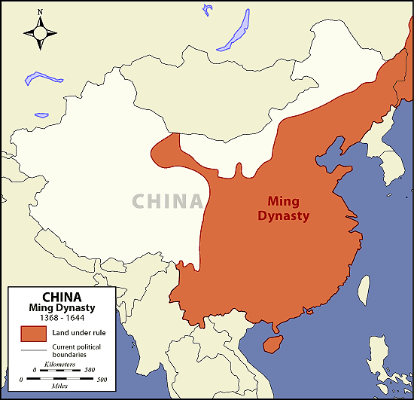
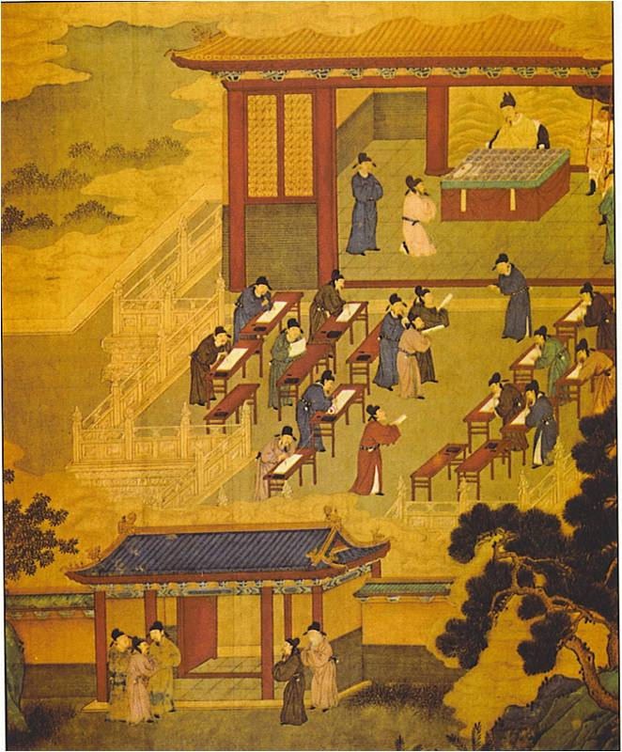
IV. Ming Dynasty (1368-1644)
A. Peasants defeated the last of the Mongol armies and claimed the mandate of heaven
B. Restored culture based on Confucianism and civil service

Slide 34
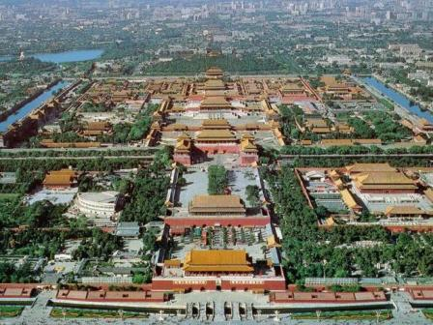
C. Ruled from Forbidden City complex in Beijing, Emperor became isolated from his people – WHY?!?!

Slide 35
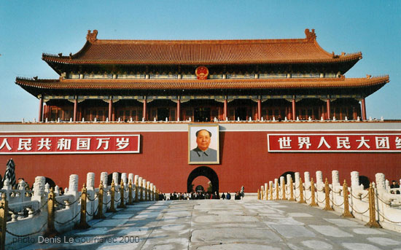

Slide 36
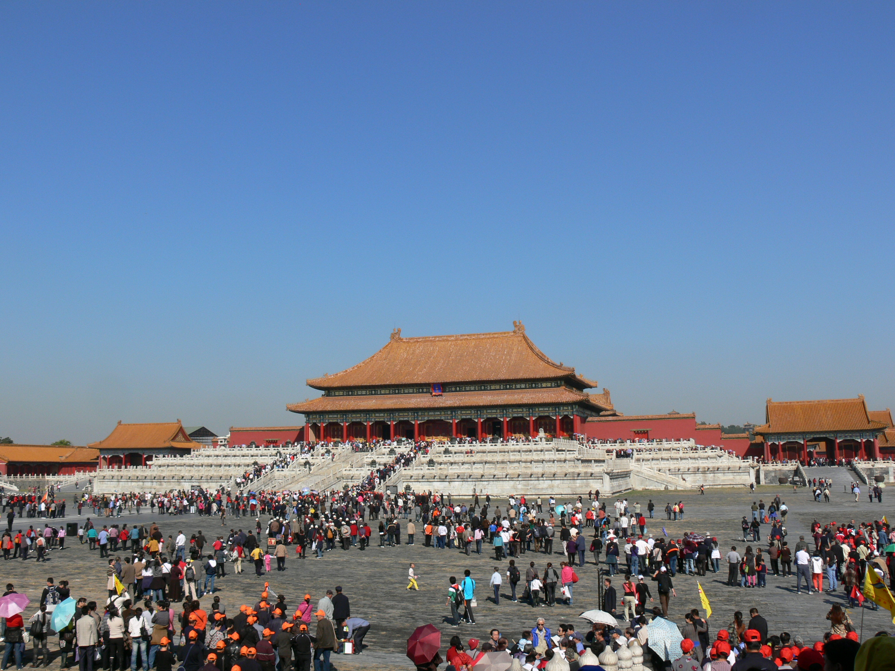

Slide 37
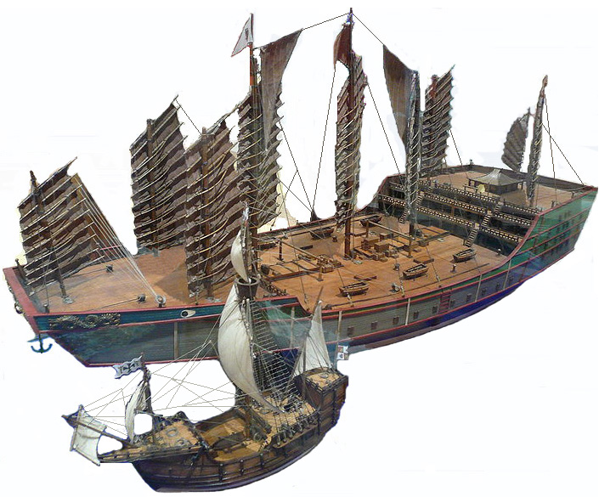
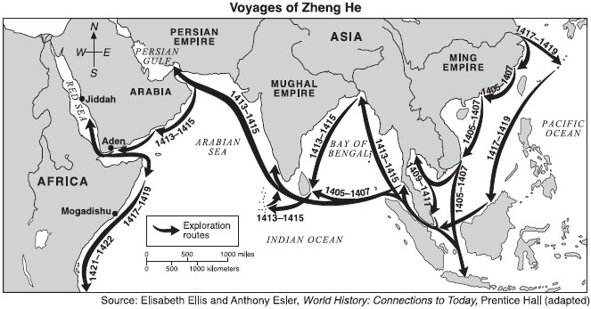
D. Foreign Relations
1. Admiral Zheng He extended Ming influence by leading a huge fleet to collect tribute from around the Indian Ocean
2. After, China became isolated but had limited trade with Europeans

Slide 38
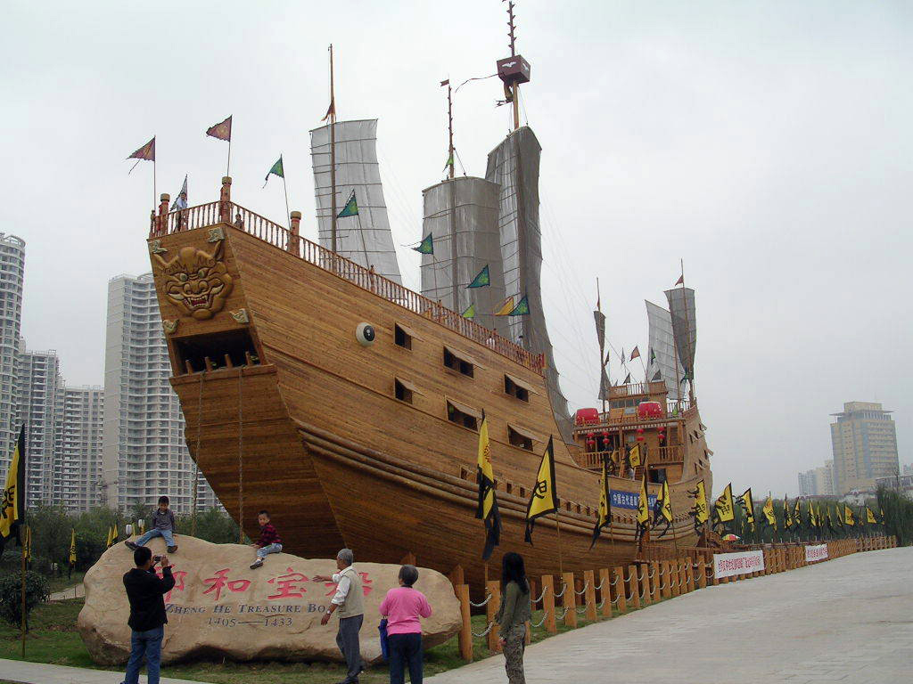

Slide 39
V. Qing Dynasty (1644-1911)
A. Manchu (NE China) invaded and started a new dynasty
B. Economy prospered with export of tea

Slide 40
C. Chinese believed that their goods and culture were superior to Europeans
D. Isolation prevented them from keeping up with European advancements

Slide 41
https://www.youtube.com/watch?v=szxPar0BcMo

Slide 42
Closure
1. Read the article that you picked up as you came into the room.
2. Answer the questions in your notebook under the heading
“Ming/America Comparison Closure”

Slide 43
JAPAN!!!

Slide 44
Warm Up
1. What was a common goal of conquest and exploration?
2. Why were the Janissaries so successful at the enlargement and management of the Ottoman Empire?
3. Why did Ming and Qing Emperors feel that it was a “smart move” to isolate China from the rest of the Western World?

Slide 45
Test Discussion…..

Slide 46
I. Geography
4000 mountainous islands make up Japan’s archipelago- a chain of islands
Isolated but culture diffused from China through Korea

Slide 48
II. Feudal Japan Society
A. Emperors were weak religious figureheads, clans fought each other
B. One clan’s leader was named Shogun- dynastic warlord ruler of all of Japan
C. Weak Shogunate led to the rise of daimyo- powerful clan leaders with land who fought each other

Slide 49
D. Samurai- professional warrior class loyal to daimyo
1. fought with sword, bow, and horses
2. Bushido- “way of the warrior”, code of obedient service, courage, and honor

Slide 54
Bushido Worksheet – TPS
1. I will pass out a worksheet to you that I will want you to read alone at your desk.
2. Read the article first and check out the questions (no need to write down the answers)
3. After 5 minutes, I will instruct you to turn and share your answers to the questions with a partner

Slide 55
E. Peasants were only allowed to farm and used rice to pay the Samurai
F. In Tokugawa Shogunate (1600 to 1867) brought back central rule and stopped internal conflict in Japan

Slide 56
III. Foreign Relations and Religion
A. At first Japanese welcomed European merchants and missionaries
B. The Tokugawa shoguns banned Christianity and cut off all Europeans except for the Dutch

Slide 57
C. Shinto- ancestor worship, all nature has a spirit, highest is sun goddess
D. Zen Buddhism- form of Buddhism that emphasizes discipline and meditation

Slide 58
KAHOOT!!!
https://play.kahoot.it/#/k/8b94204f-8246-4e5f-93fd-1a7b3a494e92
Get out your phones and log in!

Slide 59
Charts!!!
Get out the massive chart that we began working on earlier in the week (Asian Empires Chart)
Fill in the remaining empty information from the Ming/Qing Dynasties as well as Japan
Once completed, make sure it is in your notebook!

Slide 60
Extra Credit
1. What is the proper name for a small, long distance ship with triangular sails?
2. Finish this line made famous by Chris Columbus….
“I just met you, and this is crazy…..

