Slide 1
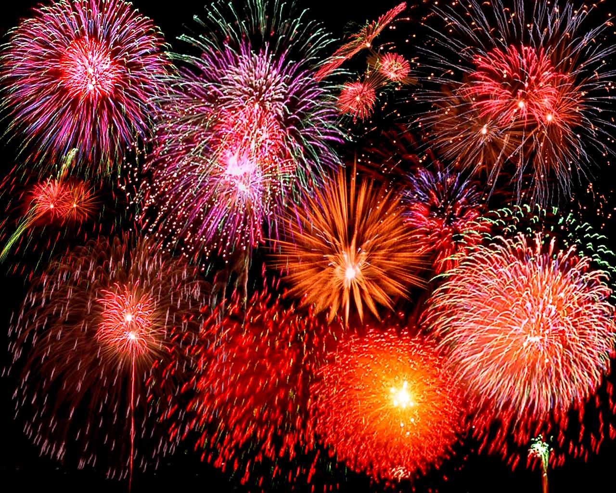
THE AMERICAN REVOLUTION

Slide 2
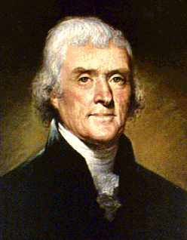
Bell-Ringer: Famous Faces Number you paper 1-6 and see if you can name these “famous Faces”!

Slide 3
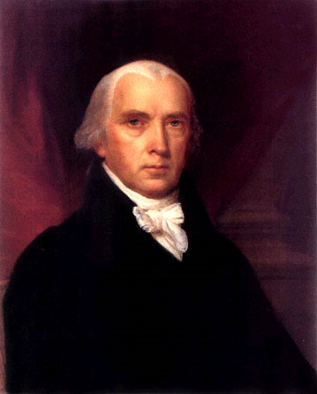

Slide 4
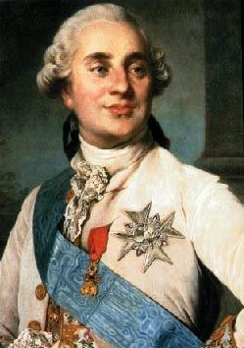
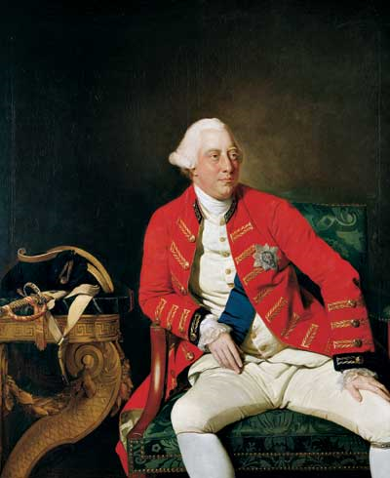

Slide 5
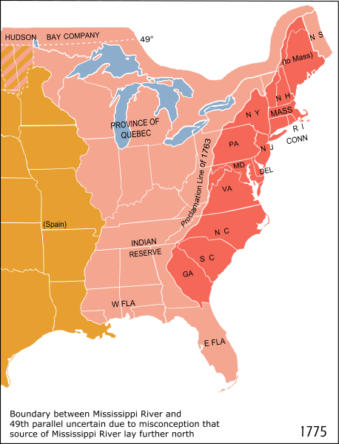
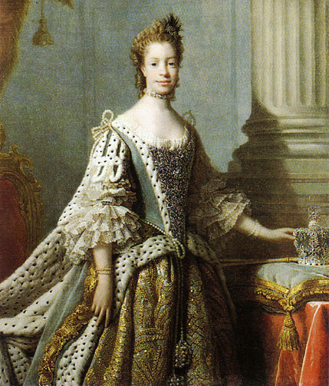
I. American Independence
A. British set up 13 self-governing permanent colonies

Slide 6
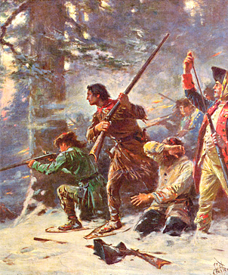
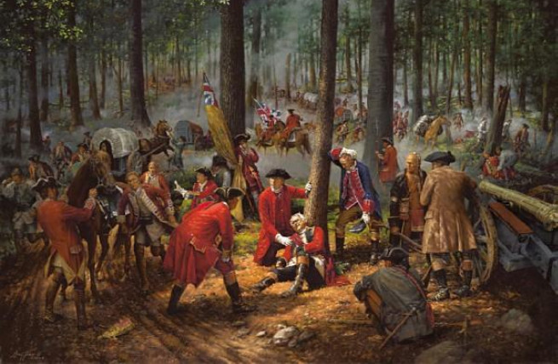
B. French and Indian War (1754-63)
1. GB and colonies vs. French and Native Americans
2. British gained French lands in America but also a large wartime debt

Slide 7
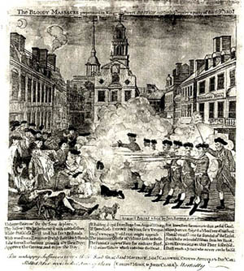
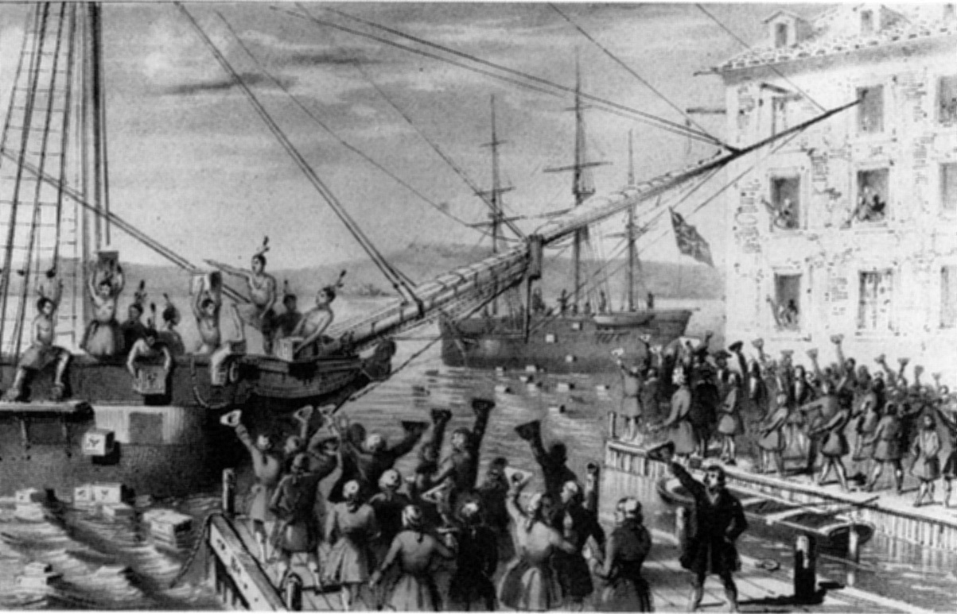
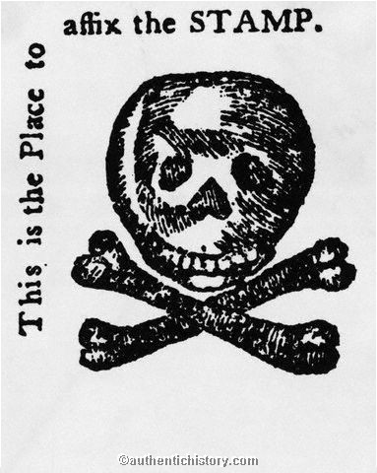
C. Rising Tensions
1. Raised taxes on many goods
2. Unrest (Boston Massacre) turned into rebellion (Boston Tea Party) http://www.youtube.com/watch?v=kGSQ2VZvzVk 23:00

Slide 8
THE EMPIRE STRIKES BACK
Intolerable Acts (1774) – essentially limited the freedoms of the colonists.
Closed Boston Harbor until East India Trading Company had been reimbursed
Granted colonial governors the right to quarter British troops in public/private buildings
Colonies respond with First Continental Congress discuss and list their grievances with the British Government

Slide 9
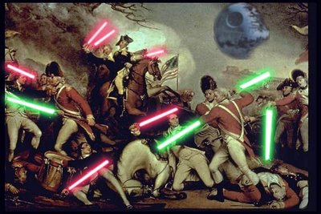

Slide 10
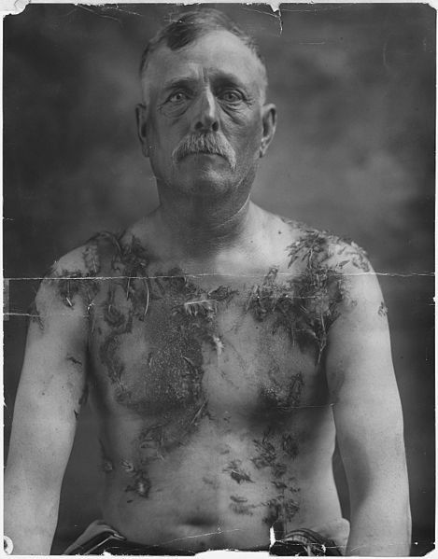
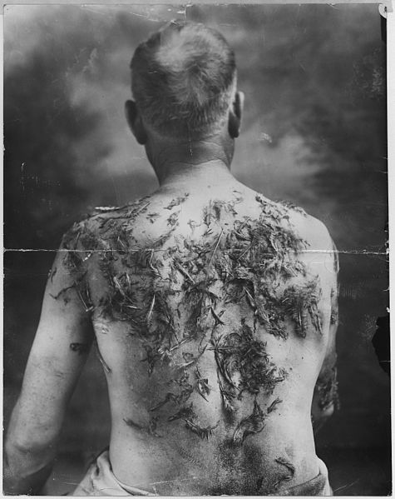
Tarring and Feathering

Slide 11
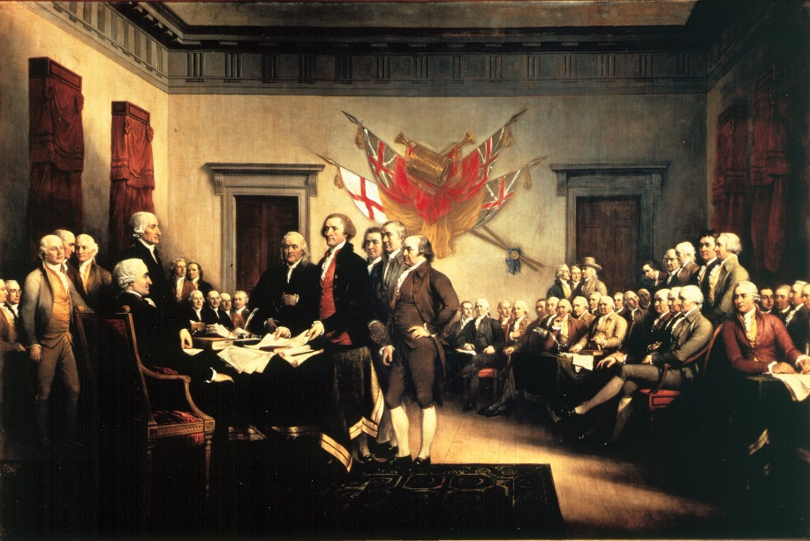
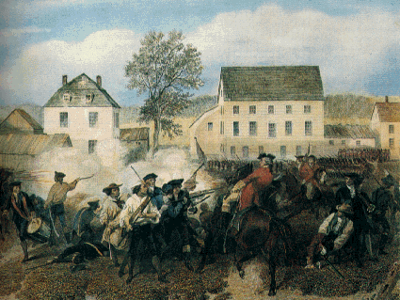
3. Continental Congress- colonies met together to work against the British
4. Lexington and Concord- first battle of American Revolution (1775)
http://www.youtube.com/watch?v=Y6ikO6LMxF4
“The Shot Heard Round the World was the Start of the Revolution” – School House Rock

Slide 12
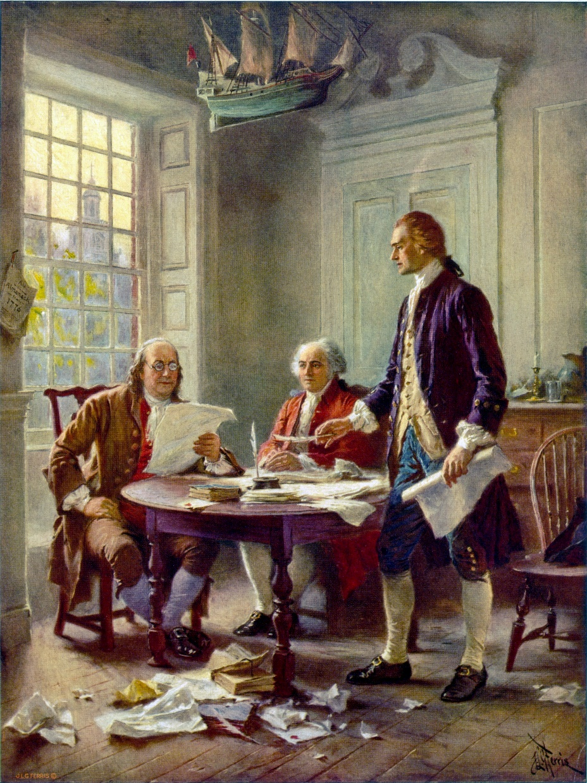
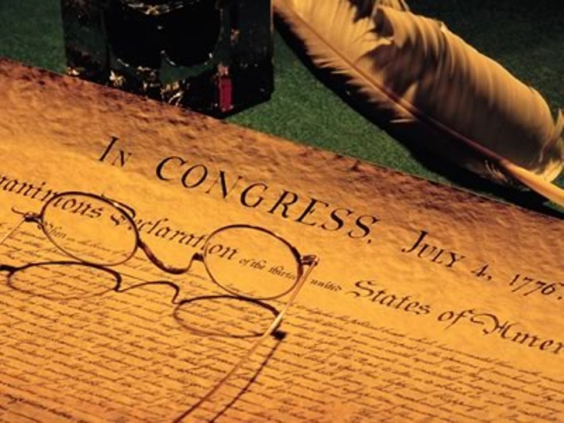
D. War of Independence
1. July 4th, 1776 the Continental Congress ratified the Declaration of Independence (borrowed the ideas of John Locke)
http://www.youtube.com/watch?v=A_56cZGRMx4

Slide 13
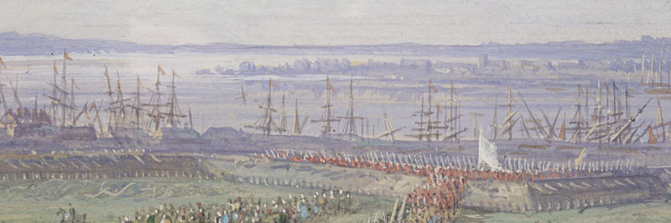
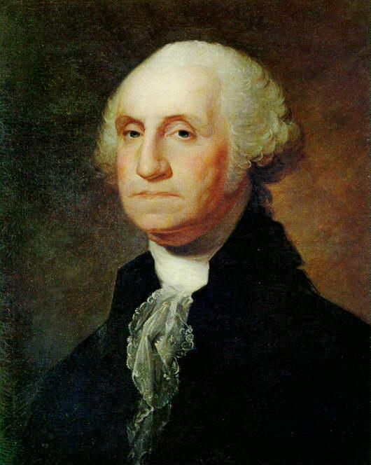
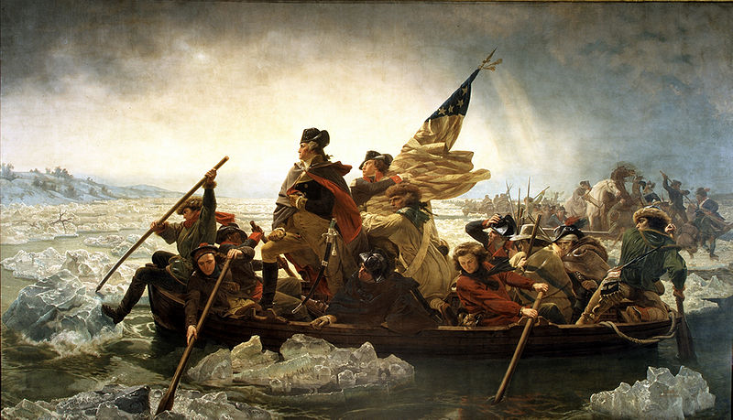
2. George Washington- led the Continental army
3. At first war went very badly, but French help turned the tide of war

Slide 14
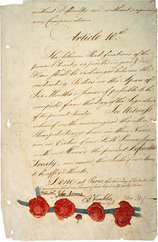
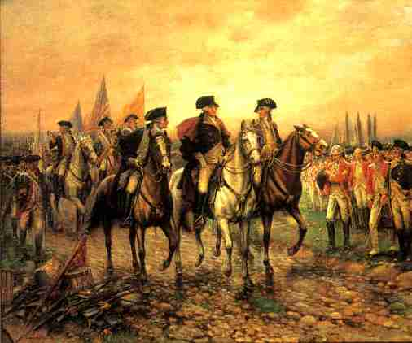
4. Treaty of Paris (1783)- Americans officially granted Independence and British lands to the Mississippi

Slide 15
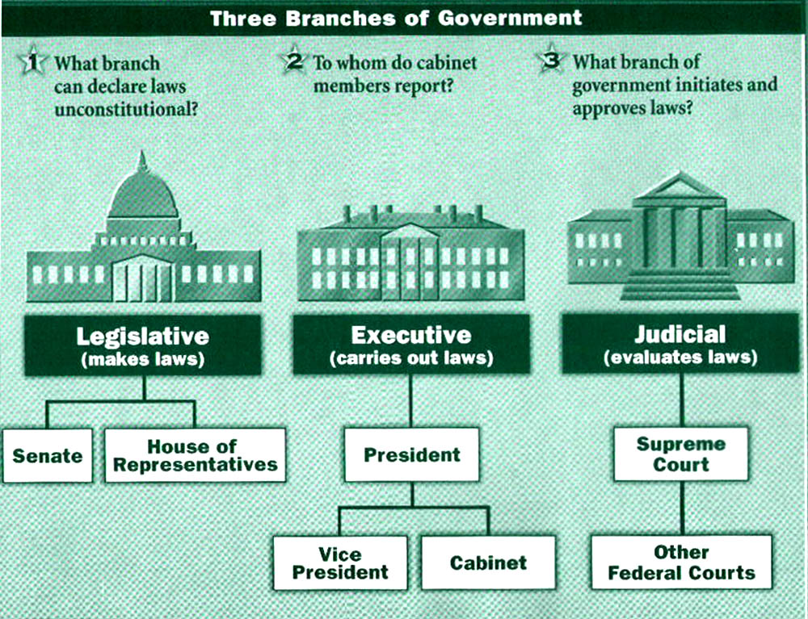
E. Impact of the Revolution
1. US Constitution united the states with a strong government
a. Created three branches (borrowed from Montesquieu)
b. Became an economic and political power

Slide 16
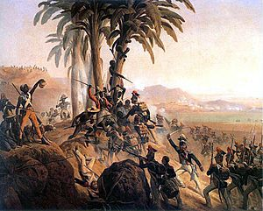
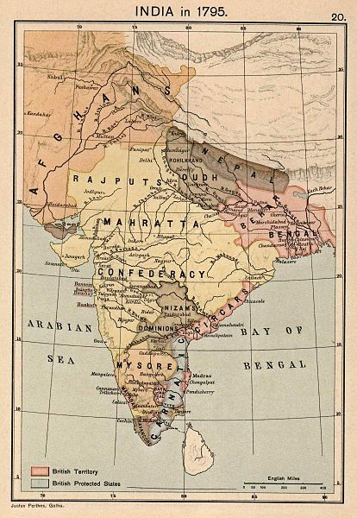
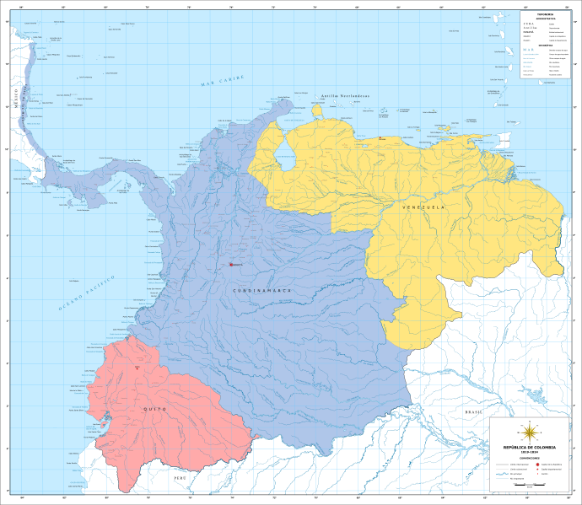
2. British remained a global power- focused on Asia
3. Other American colonies fought for independence

