Slide 1
Imperialism and Independence in the Americas

Slide 2
When Finished With the Midterm…..
Using the textbook under your desk, answer the following questions in your notebook….
Use Chapter 20 to help you out!
How was French Society divided up in the late 1700’s? Describe the division
Draw me a picture in your notes detailing this division)
Why did people hate Marie Antoinette?
What were the 5 major causes of the French Revolution?

Slide 3
Objective for Today…
Identify the causes of Revolution in Central and South America.

Slide 4
Bell-Work
Where is Haiti?
Who used to control Mexico?
Who controlled Cuba in 1905?
What does “Yellow Journalism” mean?

Slide 5
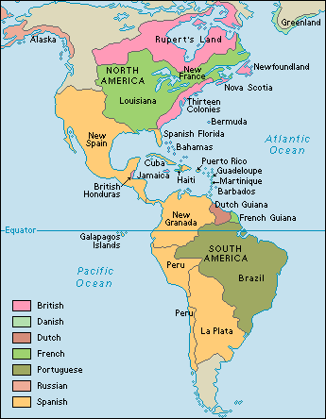
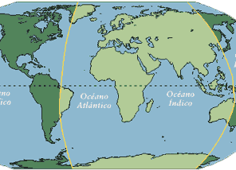
I. Independence in the Americas
A. France controlled Caribbean islands, Spain controlled Western Latin America and Portugal controlled Brazil

Slide 6
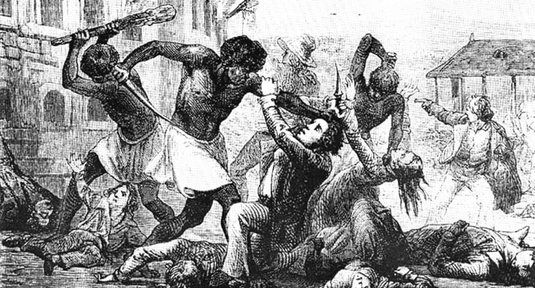
1. Haiti
a. French revolution led to revolts in the French colony of St. Domingue (Haiti)

Slide 7
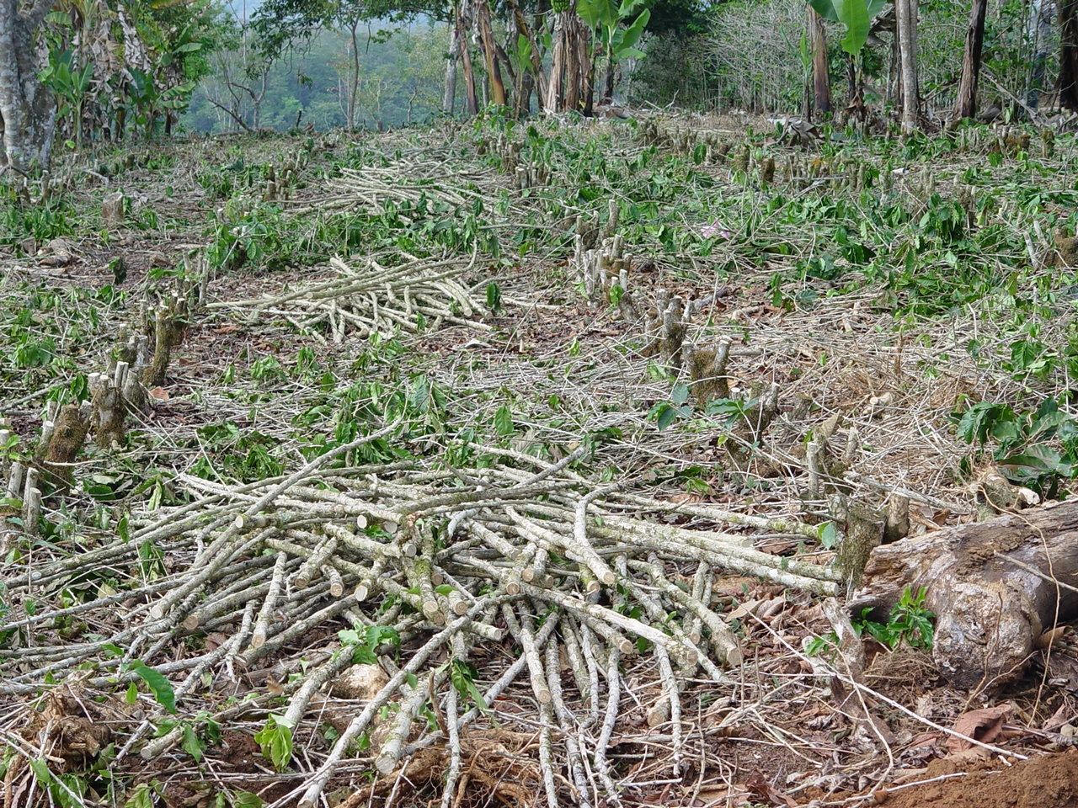
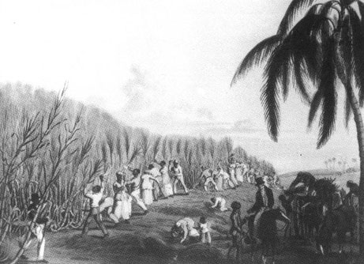
Saint Domingue (Haiti)
What was so great about it this French colony?
Sugar – largest producer in the world at 40%
Coffee - also largest producer in the world at 60%

Slide 8
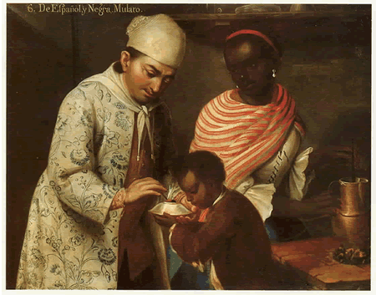
Three Classes
Whites – 40,000
Mulattoes – 28,000 – (What is a mulatto?)
African Slaves – 425,000

Slide 9
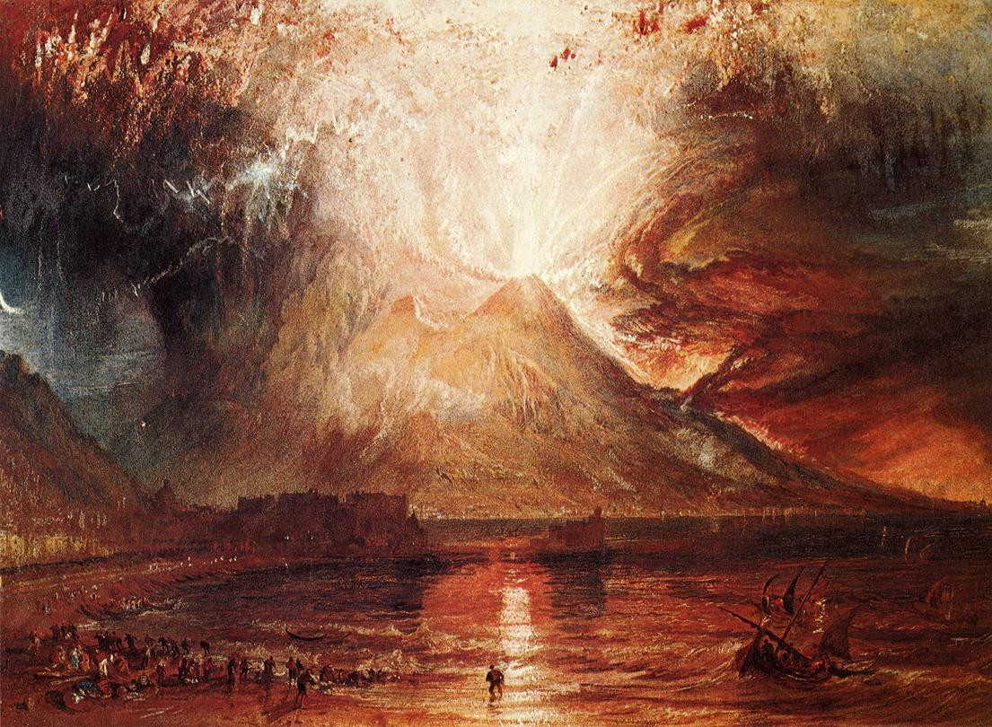
“The whites slept at the foot of Vesuvius”

Slide 10
“The whites slept at the foot of Vesuvius”
On a separate sheet of paper, answer the following:
What does this quote mean?
Why would the author choose this metaphor?
What does the painting symbolize?

Slide 11
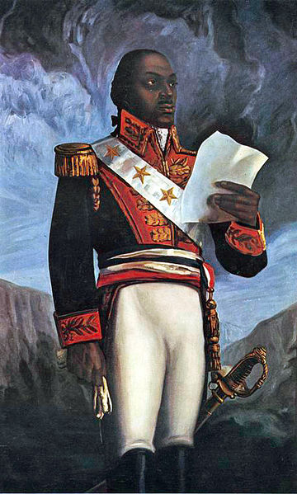
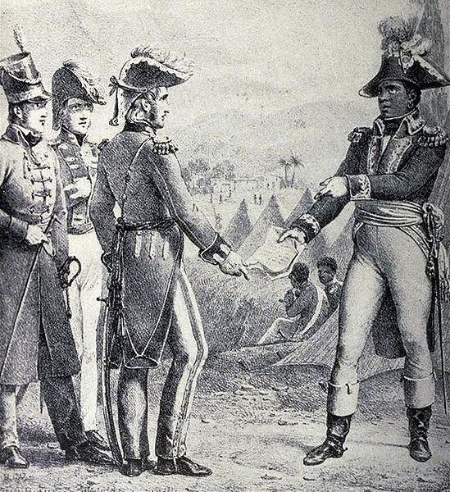
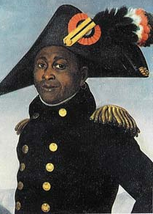
b. Toussaint L’Overture- a freed slave, led revolts and later, with the help of others, proclaimed Haitian independence in 1803

Slide 12
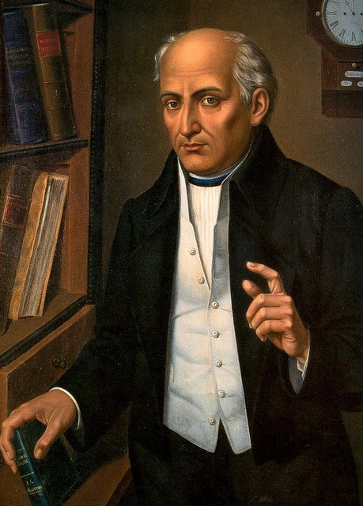
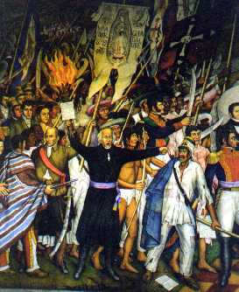
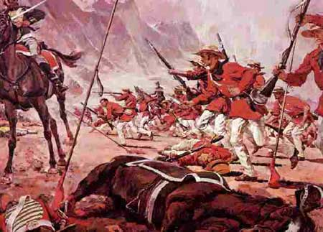
2. Mexico
a. Father Hidalgo- called for independence
b. After 10 years of war, Mexico became an independent monarchy ruled by creoles (1821)

Slide 13
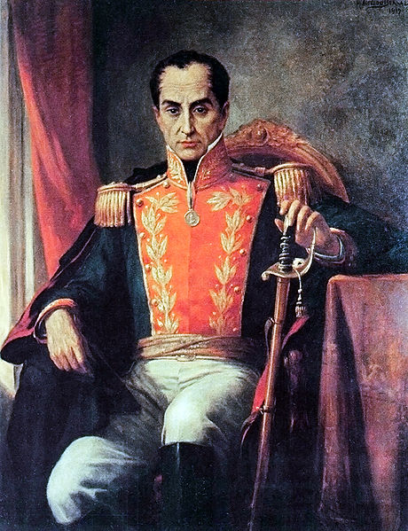
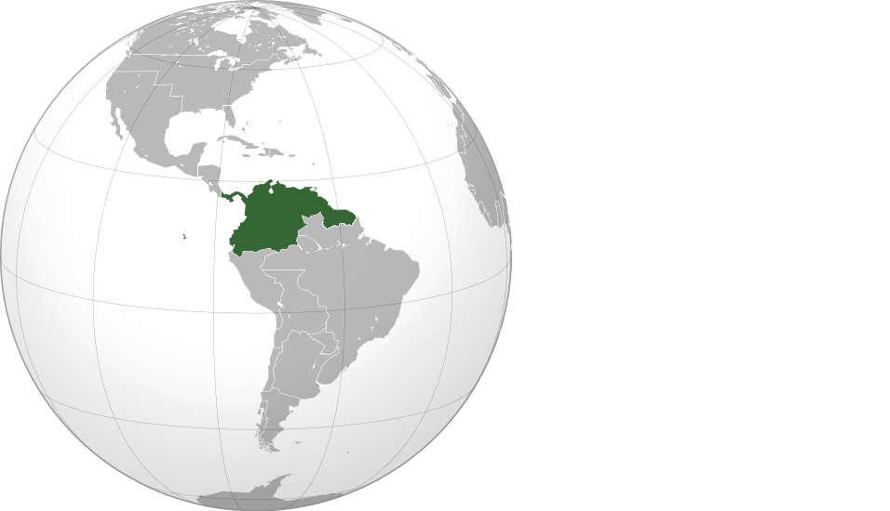
3. Simon Bolivar- helped northern South American countries win independence; wanted to unite South America into a single country

Slide 14
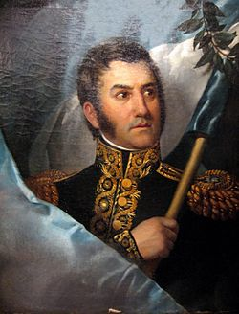
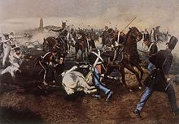
4. Jose de San Martin- helped southern South Americans countries win independence

Slide 15
B. Role of United States
1. In 1820s, set policy of Monroe Doctrine- no more European colonization in Americas

Slide 16
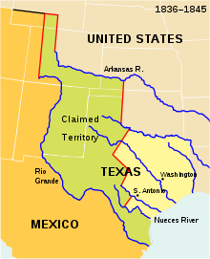
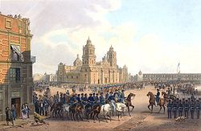
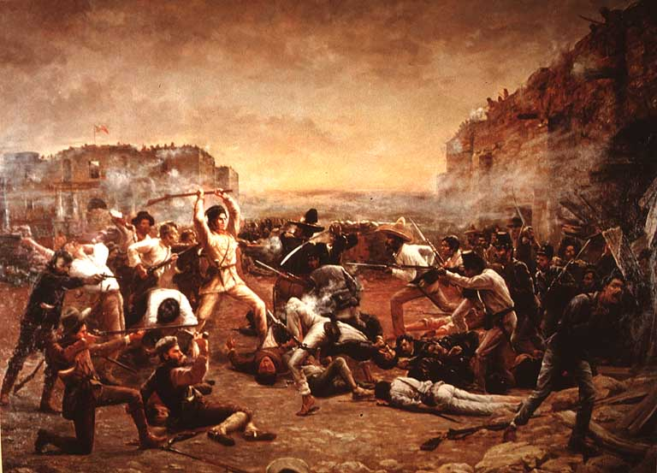
2.US won Mexican-American War and gained large territory

Slide 17
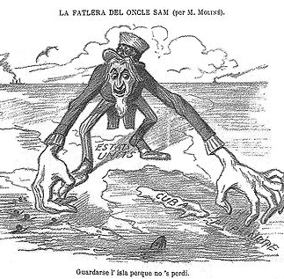
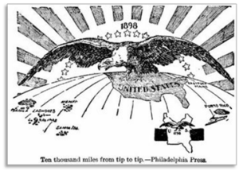
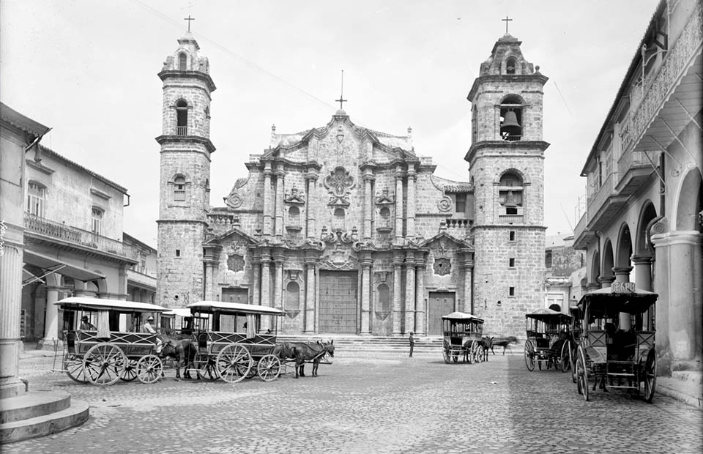
3. After Spanish-American war, US controlled Cuba, Puerto Rico, and Panama

Slide 18
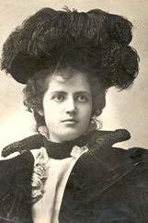
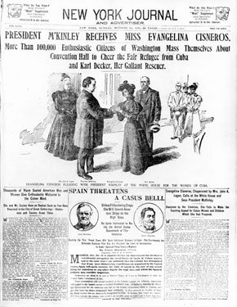

Slide 19
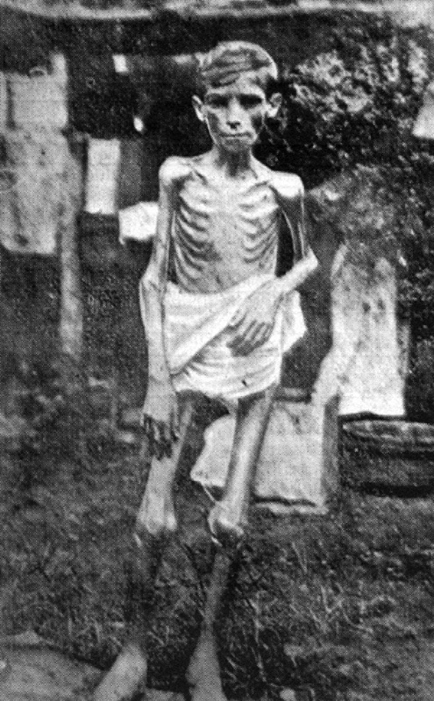

Slide 20
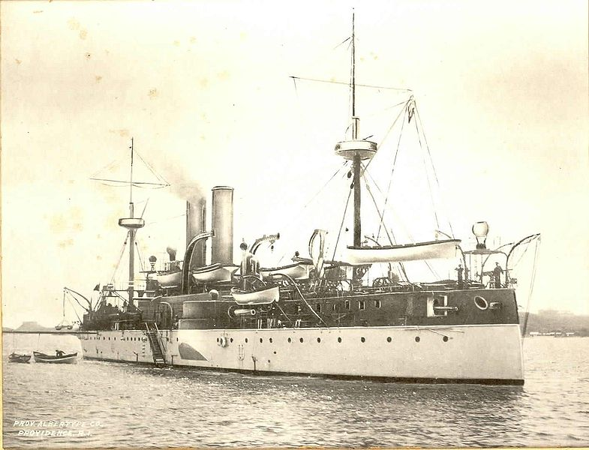

Slide 21
