Slide 1
African Imperialism

Slide 2
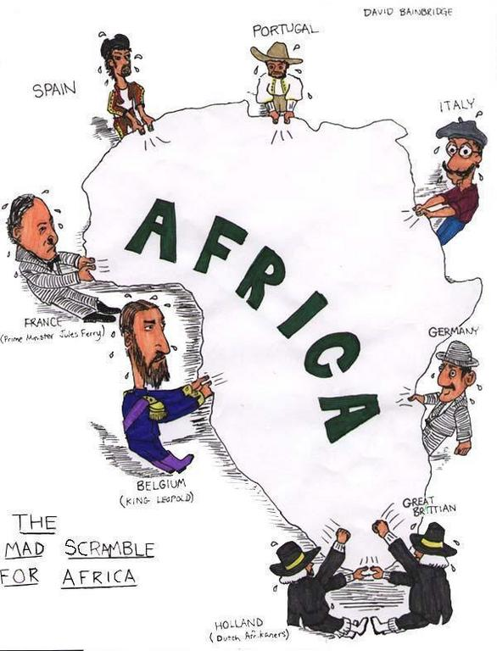
Warm Up
In 5 minutes, create a 2-column table listing as many positive and negative outcomes of colonization.

Slide 3
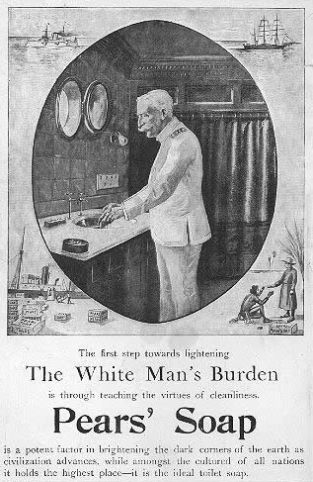
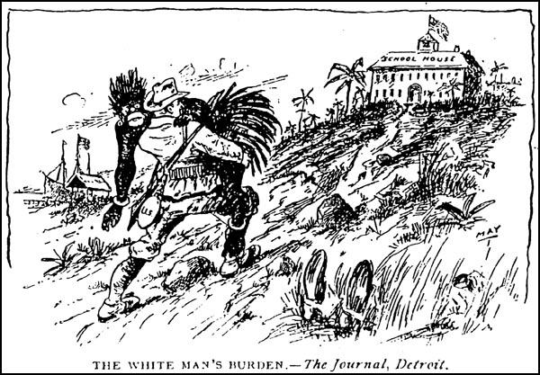
White Man’s Burden
Many Europeans justified their actions because they believed that Africans were unable to govern themselves. They subscribed to a belief of “White Man’s Burden”, meaning that it was the European’s duty to civilize, educate, and convert the inhabitants of their colonies.

Slide 4
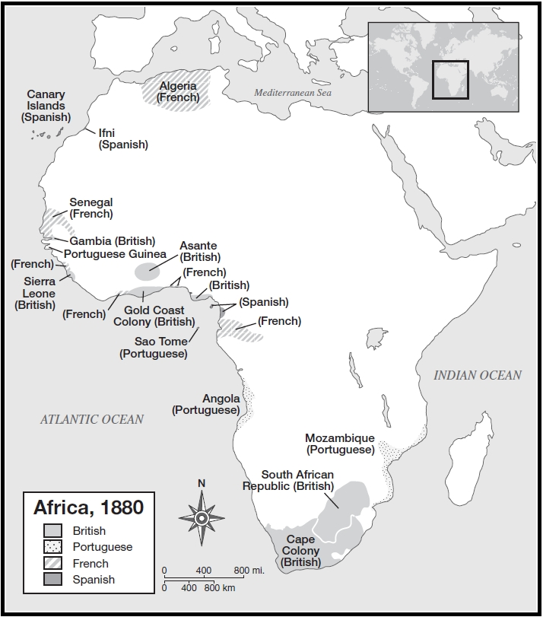
I. Imperialism in Africa
A. Scramble for Africa (1880-1914)
1. Disease had prevented Europeans from creating colonies
a. As of 1880- less than 10% of African continent controlled by Europeans

Slide 5
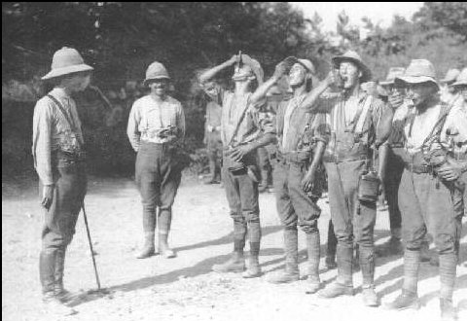
2. New medicines allowed Europeans to compete for Africa’s resources
a. New drug could fight diseases (quinine)

Slide 6
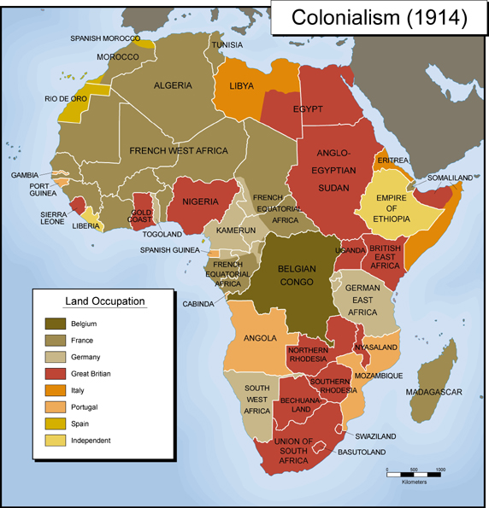
B. New Imperialism
1. Europeans sought to dominate African peoples
a. Europeans driven by economic interests, political competition and cultural motives

Slide 7
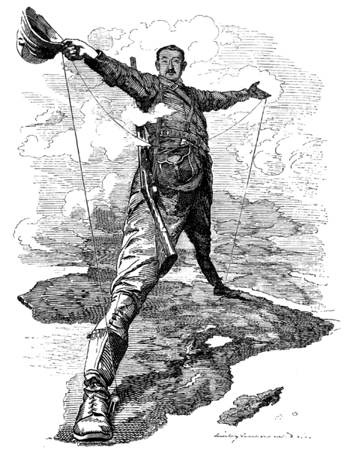
2. Social Darwinism- belief that certain races are inferior to others
Based on the ideas of Charles Darwin’s natural selection theory
Cecil Rhodes- British businessman who was an advocate of Social Darwinism

Slide 8
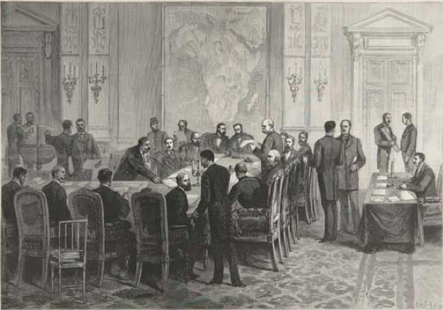
3. Berlin Conference- European nations agreed on how to split up Africa
a,. Had to prove you could hold onto the land
b. No single European power could claim the entire continent
2. French and British biggest powers in Africa

Slide 9
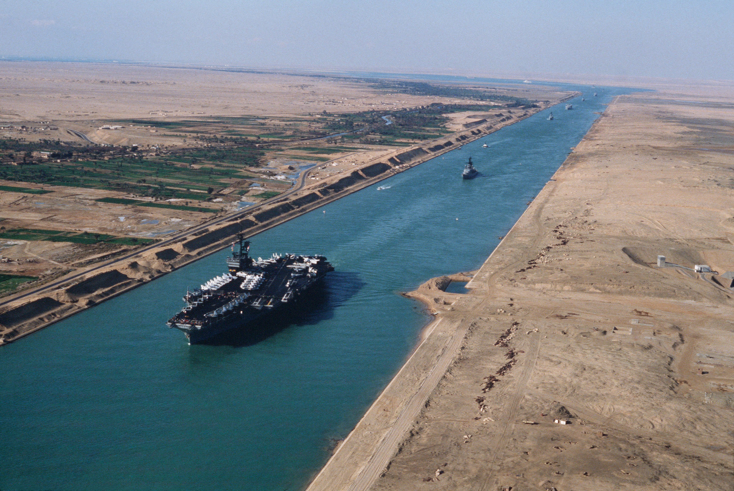
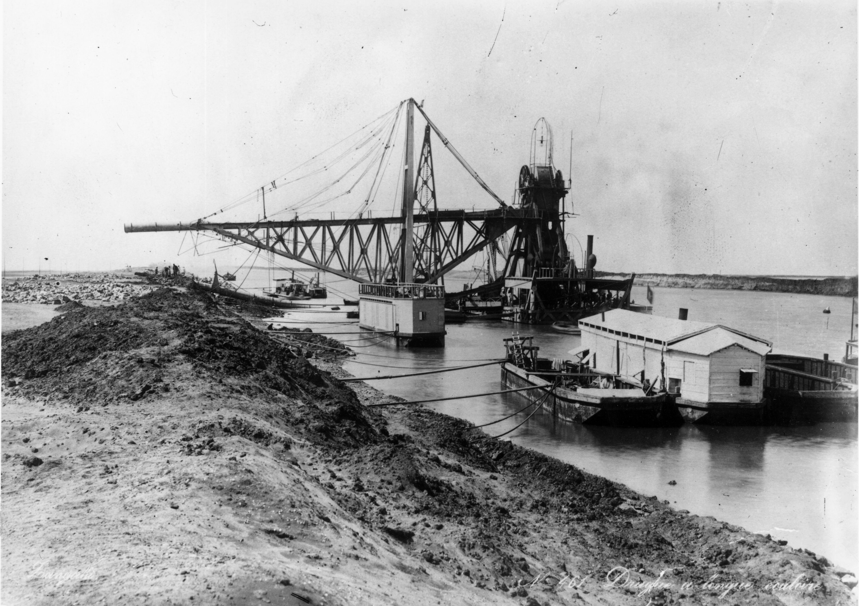
II. Regions Imperialized
A. Egypt (British)
1. Suez Canal- linked Mediterranean sea with red sea, shortening trip from England to Indian ocean

Slide 10
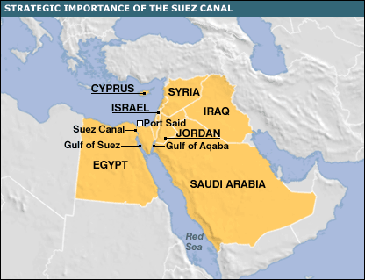

Slide 11
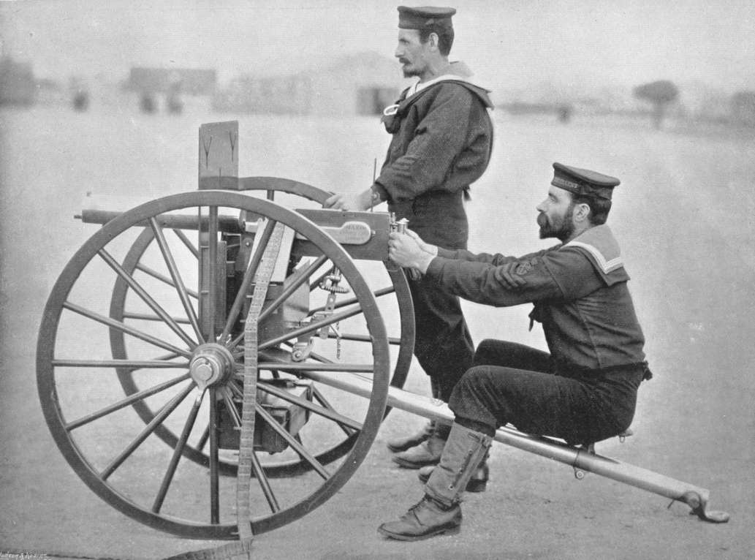
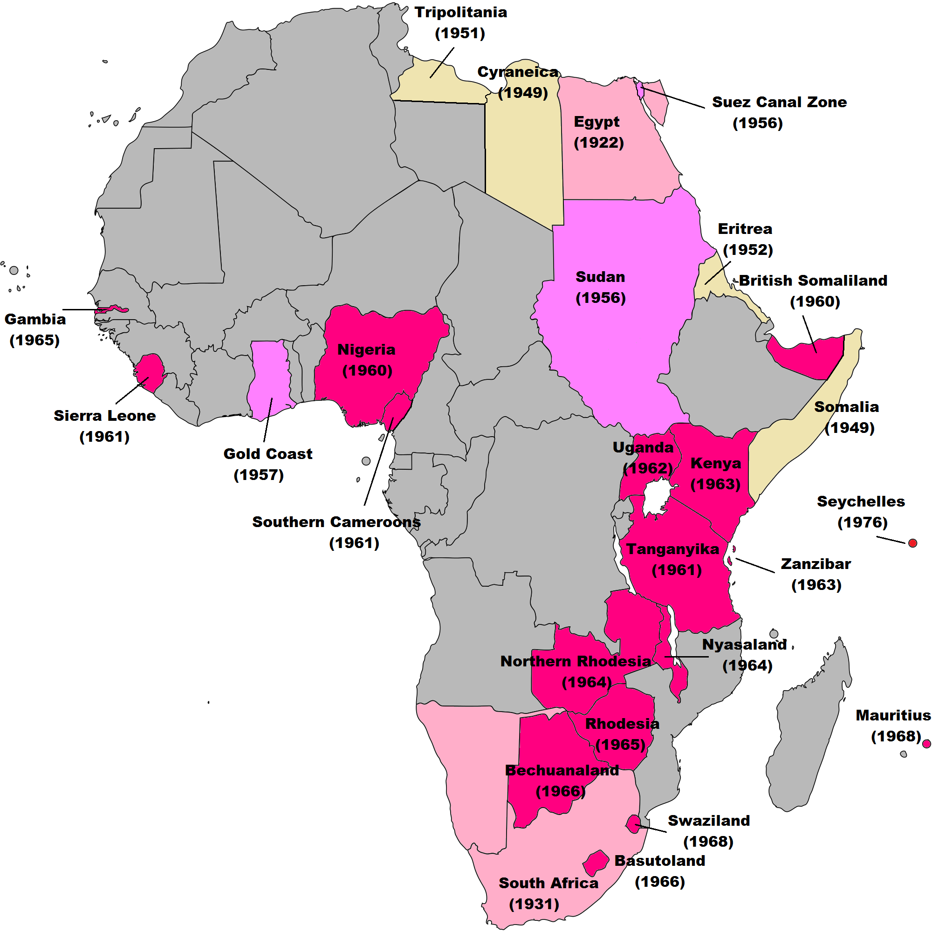
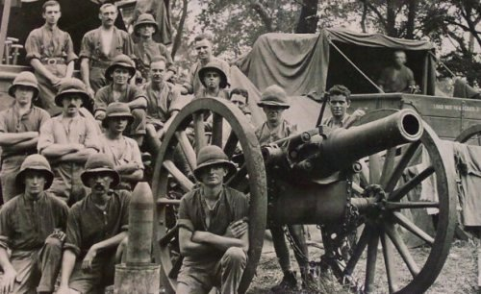
2. British occupied Egypt in 1882 to protect its interests and gain control

Slide 12
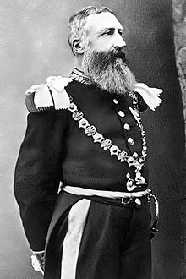
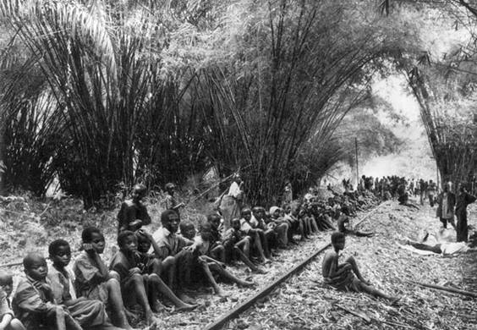
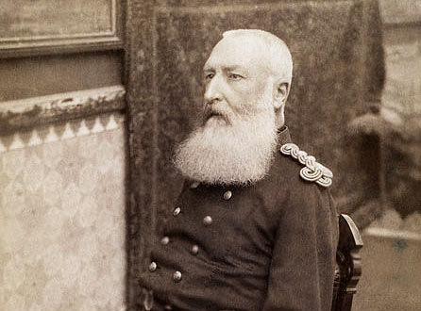
B. French controlled West Africa
C. The Congo (central Africa)
King Leopold II- (Belgium) claimed the territory for himself
Created a personal fortune; exploited natural resources (rubber)
Abuse of Africans led to death of 10 million

Slide 13
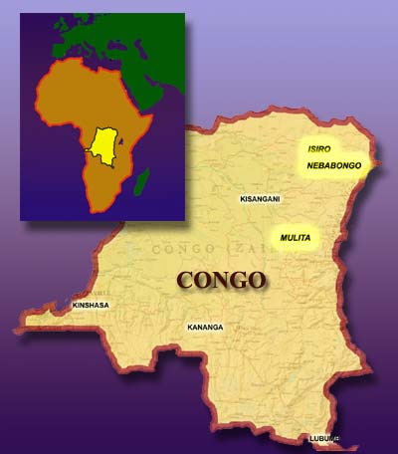
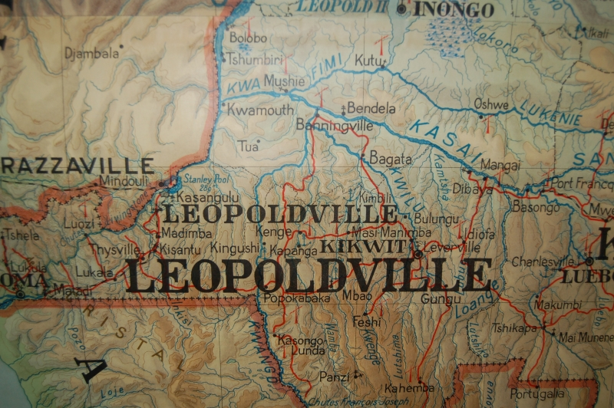

Slide 14
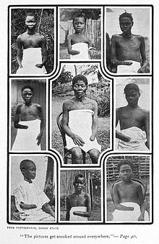
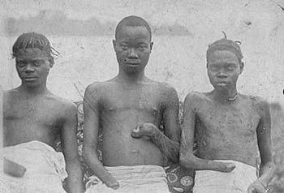

Slide 15
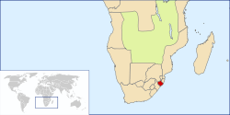
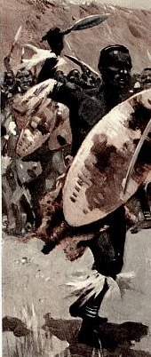
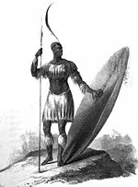
D. British in South Africa
1. Zulu
a. African tribe united by Shaka Zulu
b. Shaka’s nephew fought the British and won a victory before being defeated by British

Slide 16
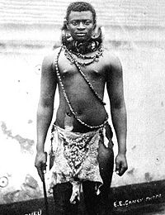
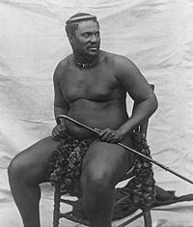

Slide 17
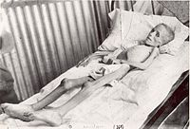
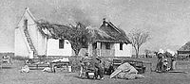
2. Boer War
a. British expanded north into Dutch (Boer) territory because gold was found- leading to war in 1899
b. British gained control but fought rebels who used guerilla tactics against British troops
c. British brutally defeated the Boers

Slide 18
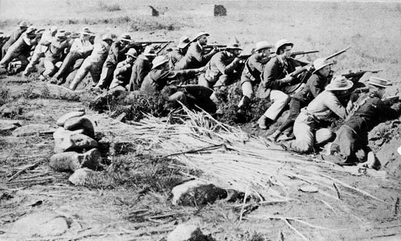

Slide 19
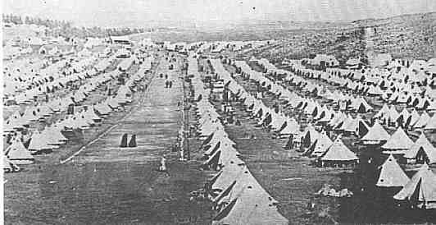

Slide 20
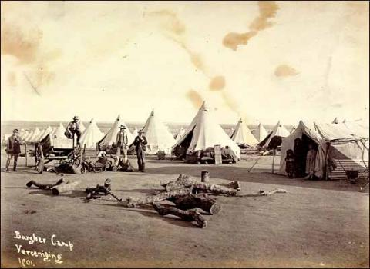

Slide 21
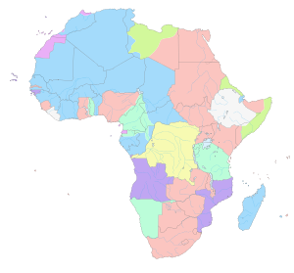
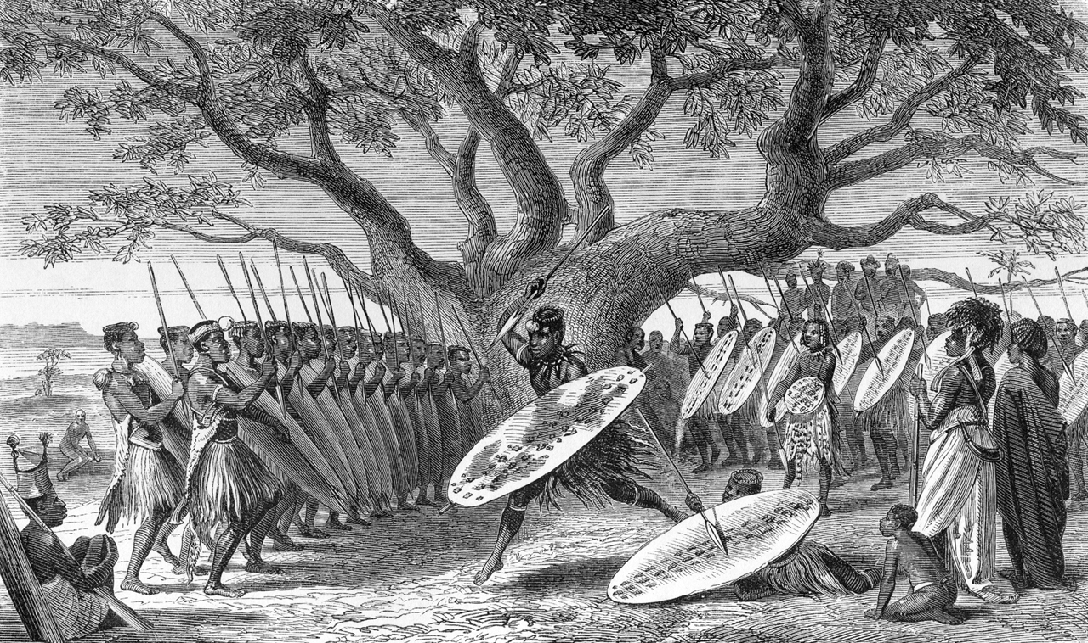
III. Effects of African Imperialism
A. African tribes were split between colonies
B. Tribes were pitted against each other in colonies as a way to keep European control

Slide 22
Colonial Africa:1914
What are some potential problems that could result from Europeans changing boundary lines throughout the African continent?

Slide 23
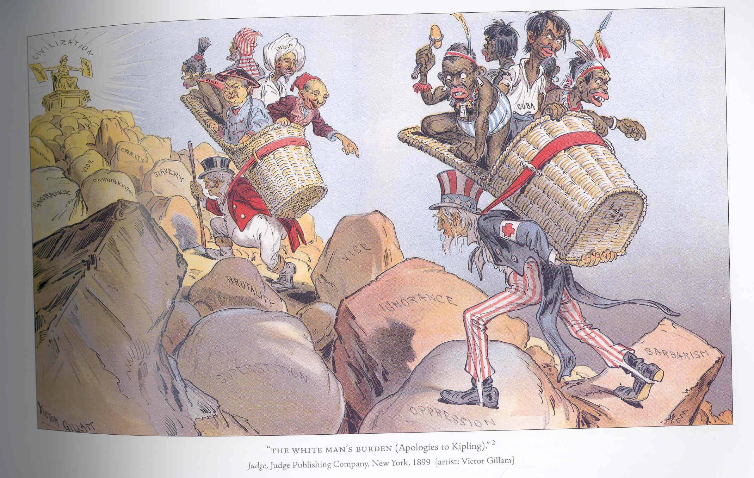
C. Economic poverty in Africa
D. Lack development- Africa used for resources

